Slide 1
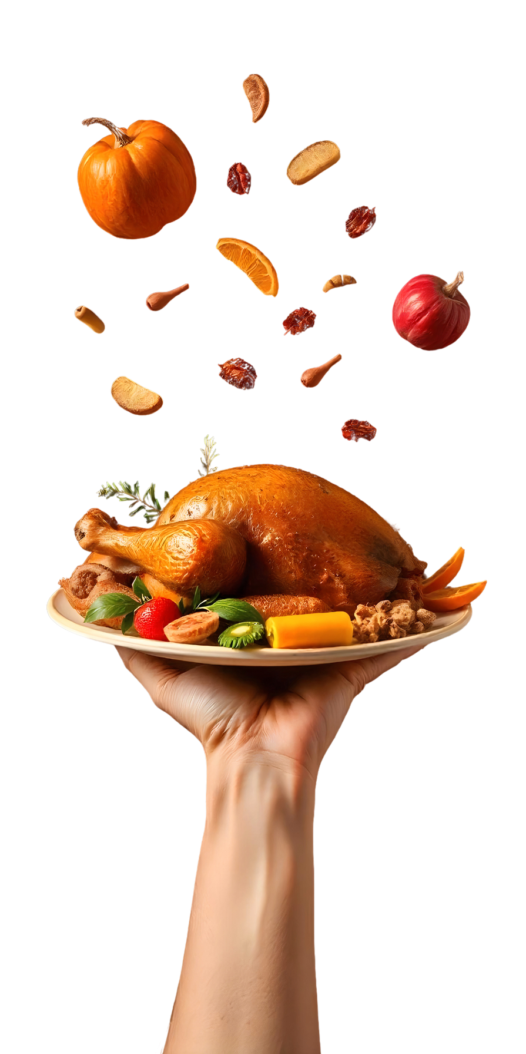




Thanksgiving
SIGN UP SHEET
potluck
SUNDAY
Nov
Community Center Hall, 123 Main Street Hometown, USA
28
6PM—
8PM
with Chef
Sophia Marie
FULL NAME | PHONE | DISHES | QUANTITY

