Slide 1
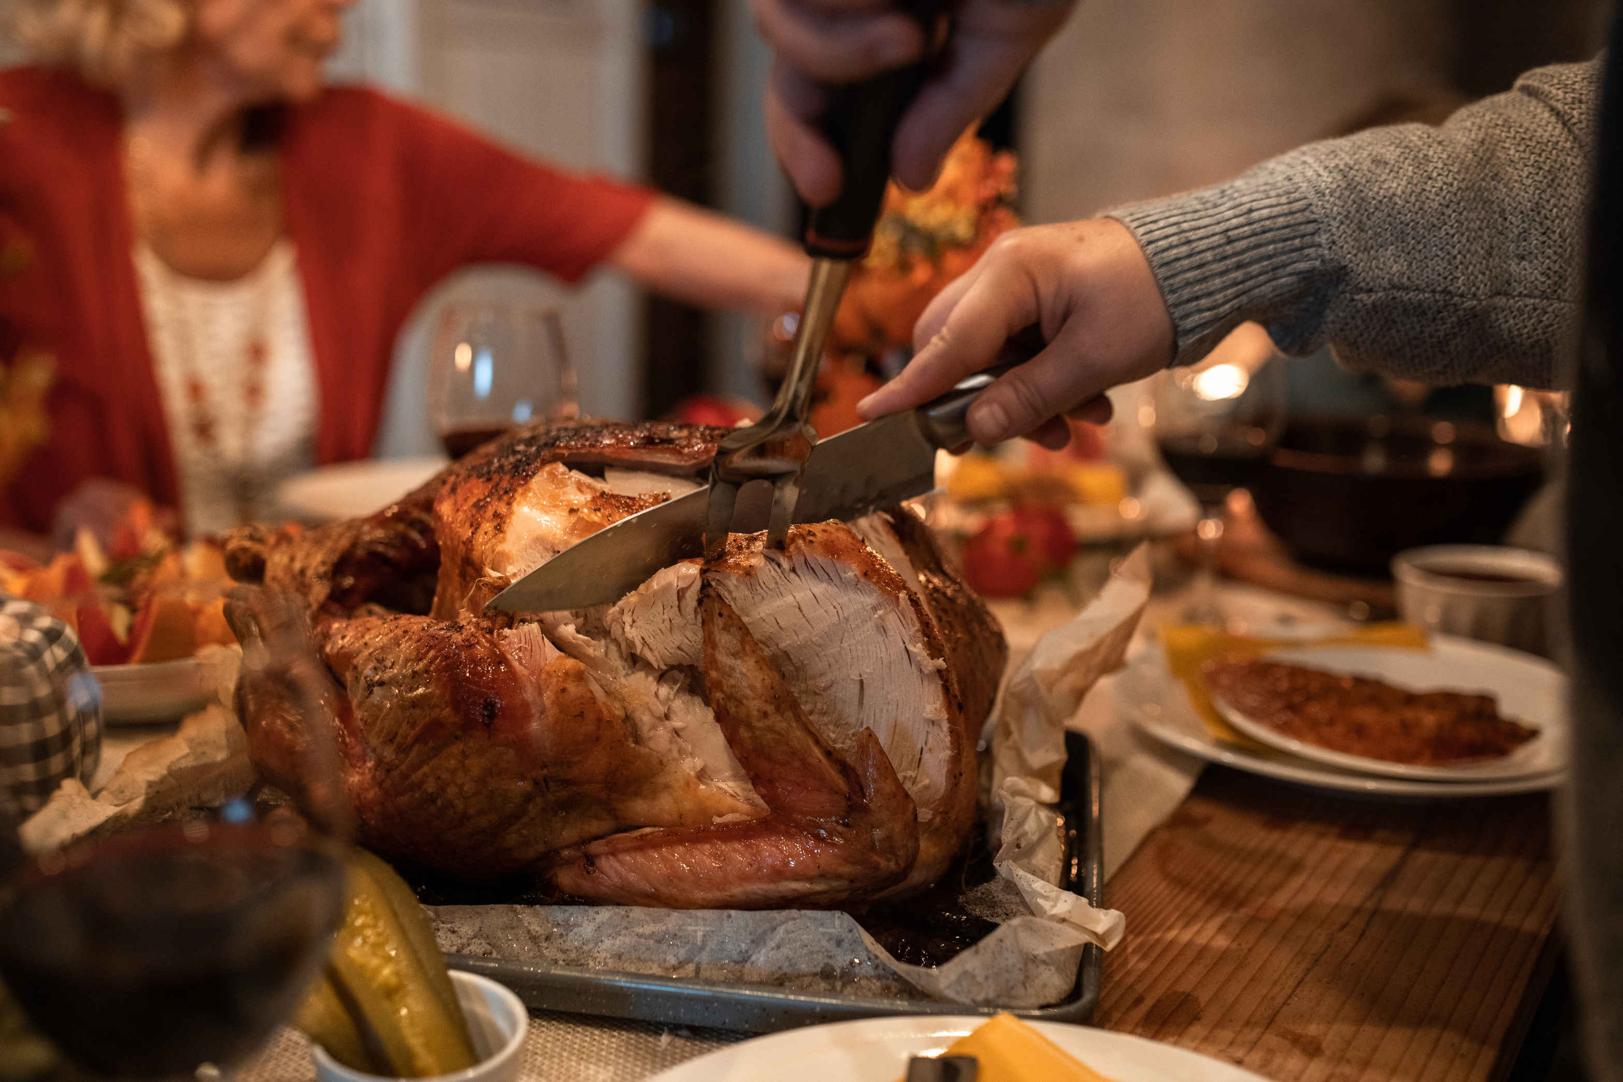


SIGN UP SHEET
Friendsgiving
At Sarah’s home
29/11
15 PM
Full Name | Phone | Will Bring | Quantity | Note
Sarah’s home | 123 Anywhere St., Any City
+123-456-789 | Sarah Green - Host

