Slide 1
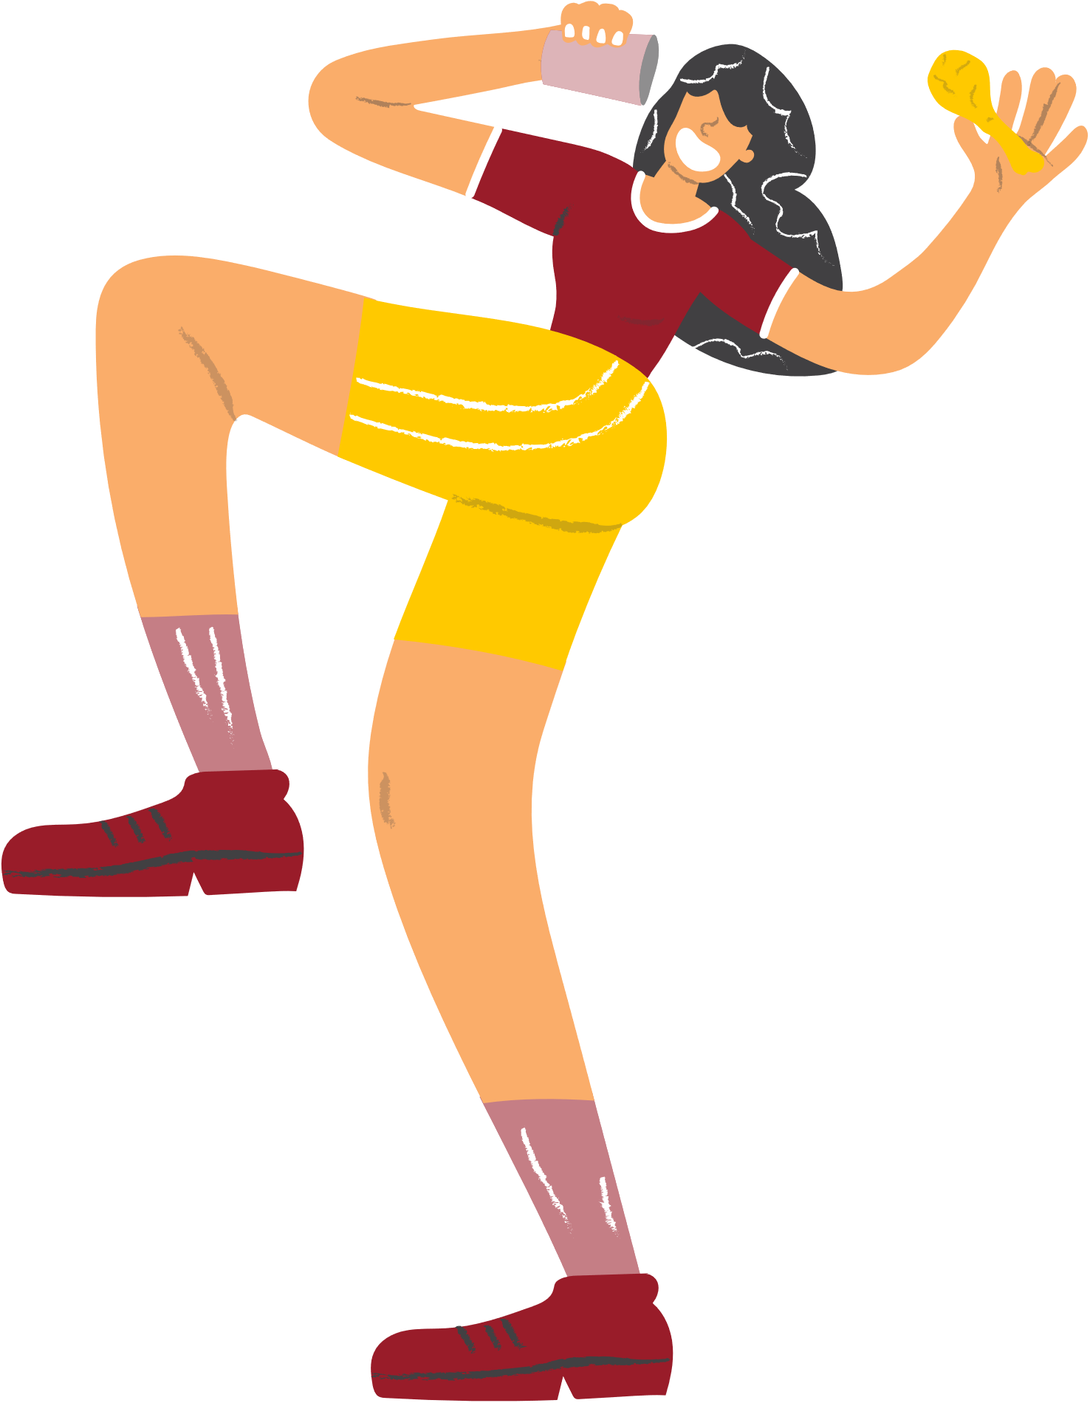
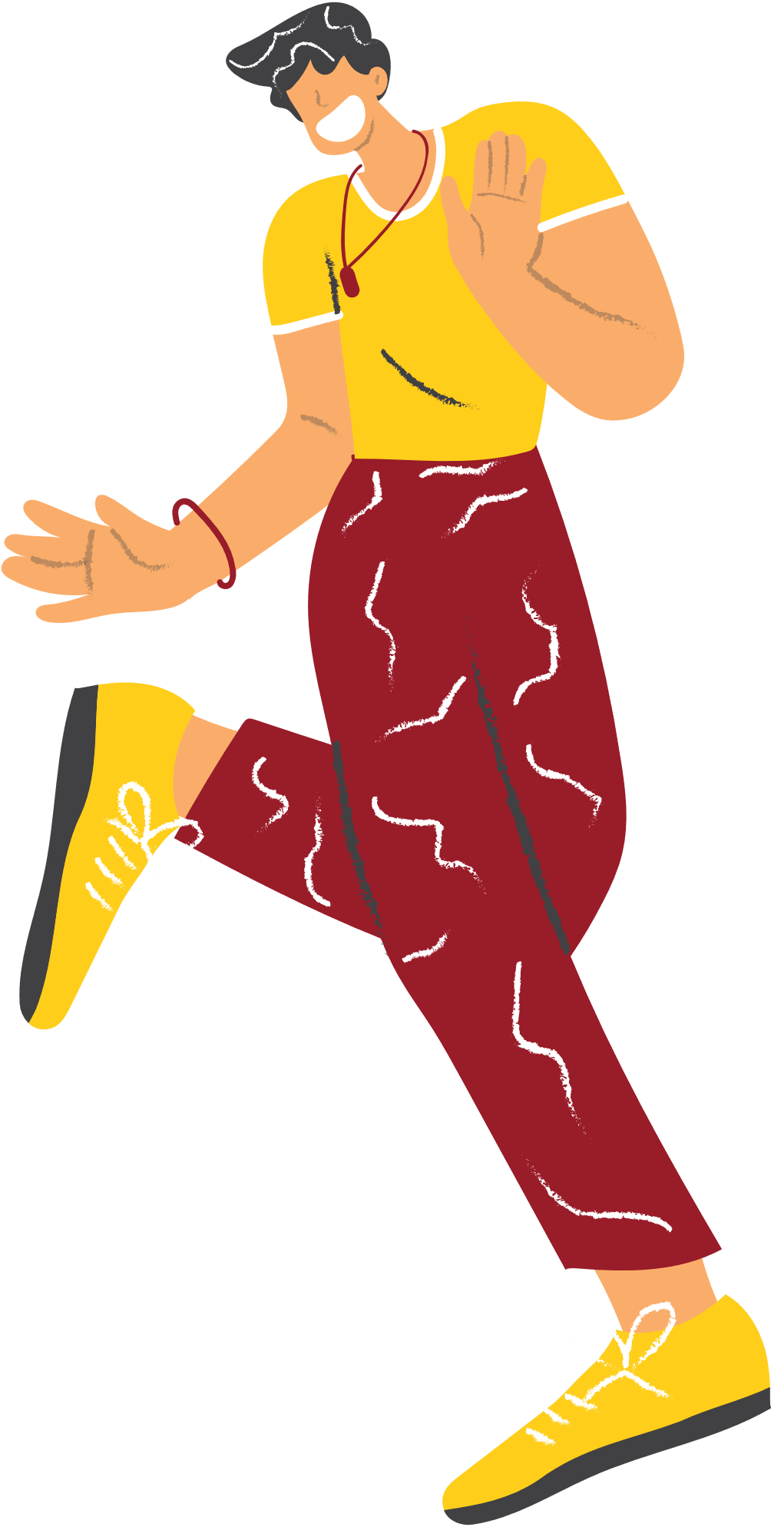




PARTY
SIGN UP
SHEET
MARINA’S HOUSE
COCKTAIL
BAR
DINNER
SNACK
LIVE MUSIC
Full Name
Phone
Special Requests
SATURDAY, SEPTEMBER 21, 2024
7:00 PM - 12:00 PM
789 ELM STREET, FAIRVIEW, TX 75001

