Slide 1




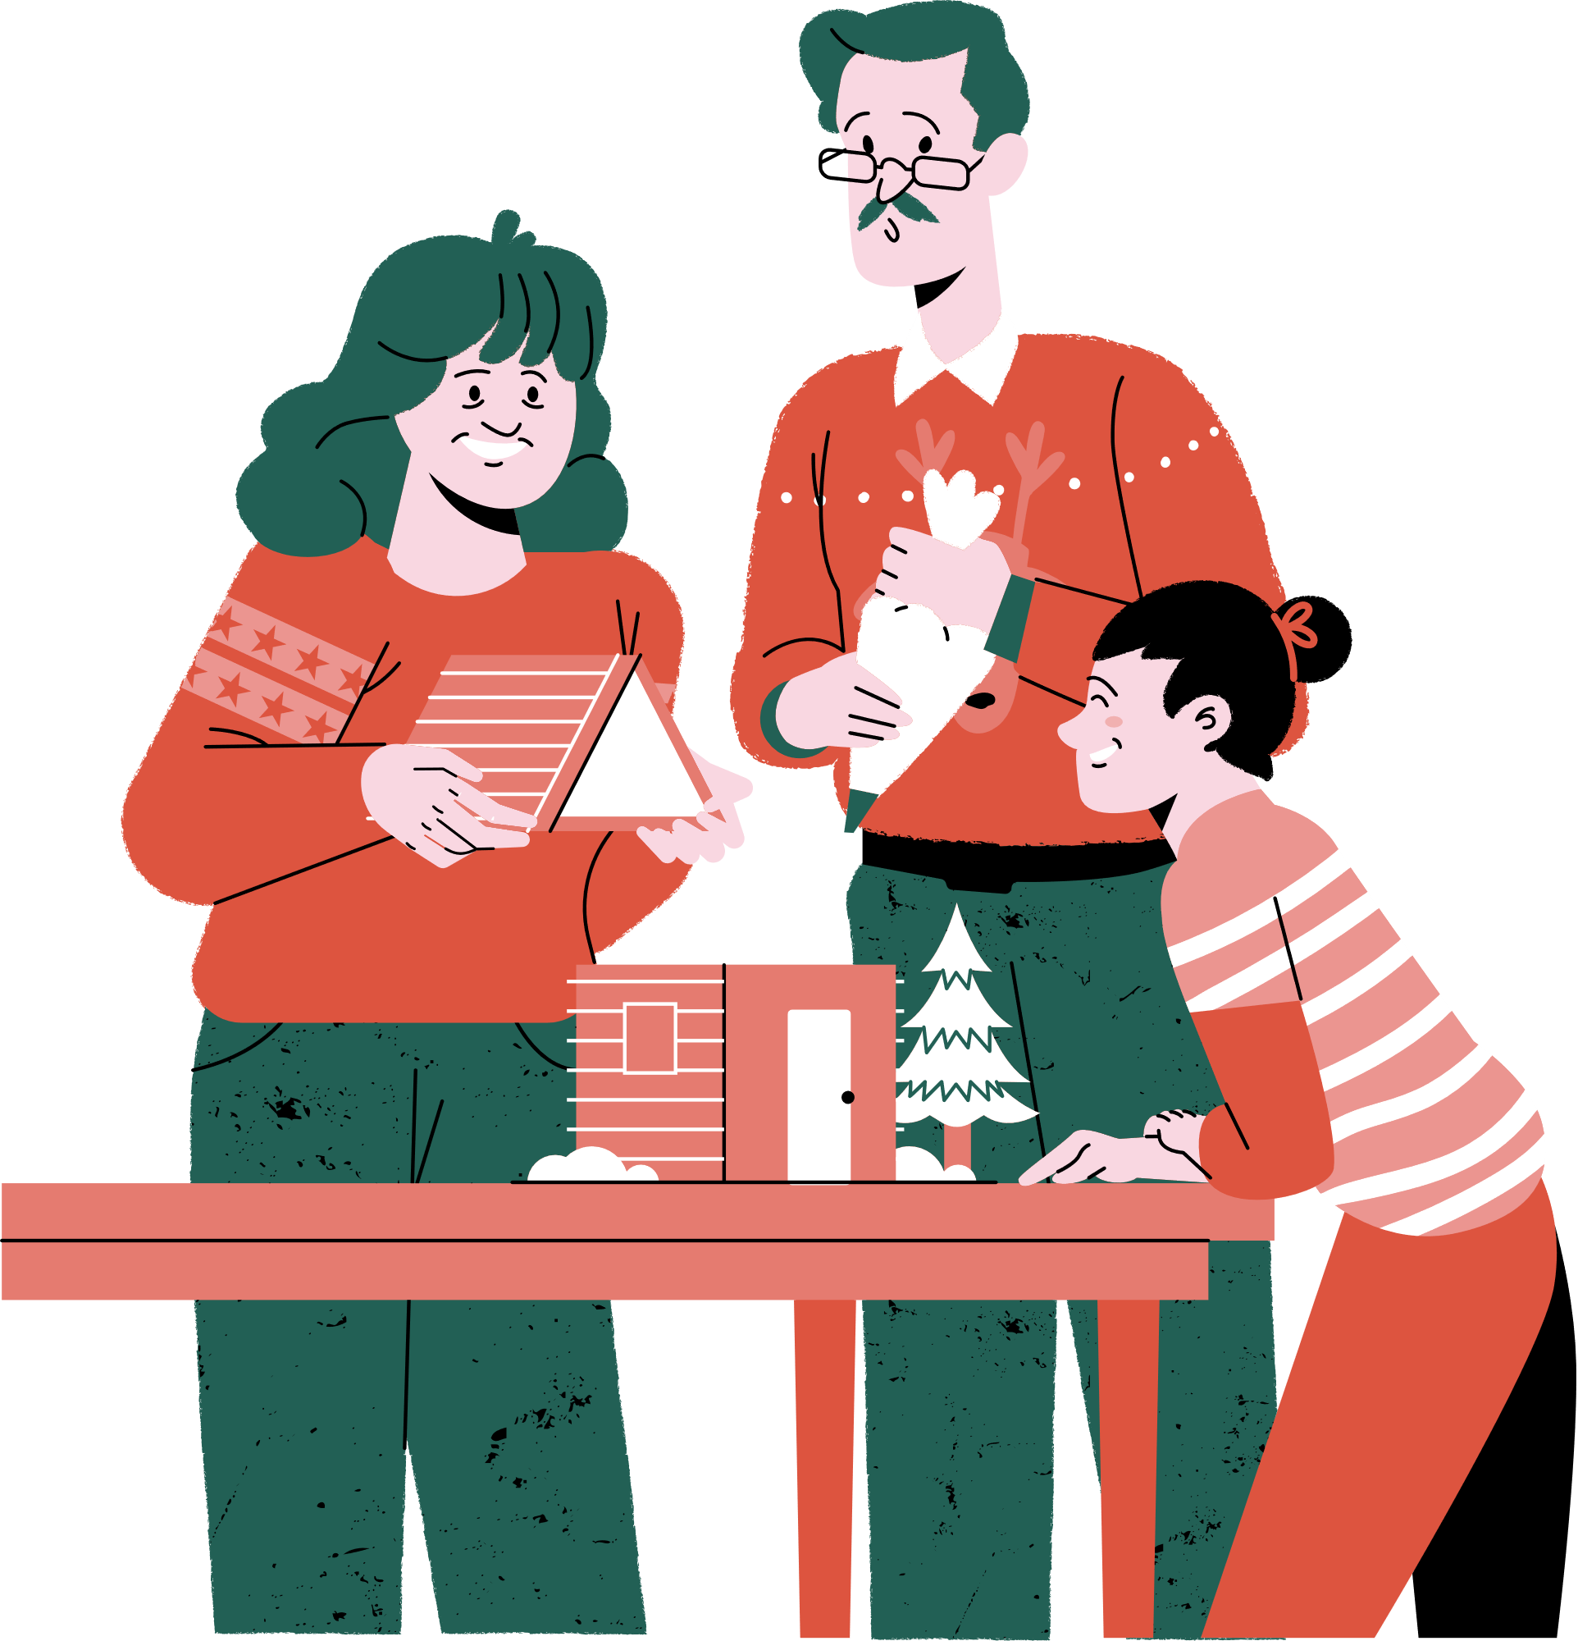



Christmas
SIGN UP SHEET
potluck
Community Center Hall, 123 Main Street Hometown, USA
25/12
4 PM
with Chef
Sophia Marie
FULL NAME | PHONE | DISHES | QUANTITY

