Slide 1
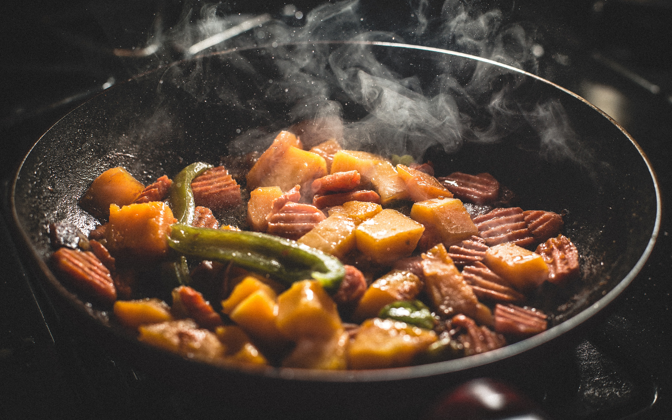


FOOD
Sign up Sheet
Date
150 Blooming Grove Lane, Greenfield Hills District
Time
Sun, Mar 25
SUNNY PARK
12:00 - 16:00
Full Name | Phone Number | Email | Item Name | Quantity
Join the fun by signing up and bringing a dish to share, ensuring a delicious event for everyone!
Sarah Thompson | sarah.thompson@email.com

