Slide 1
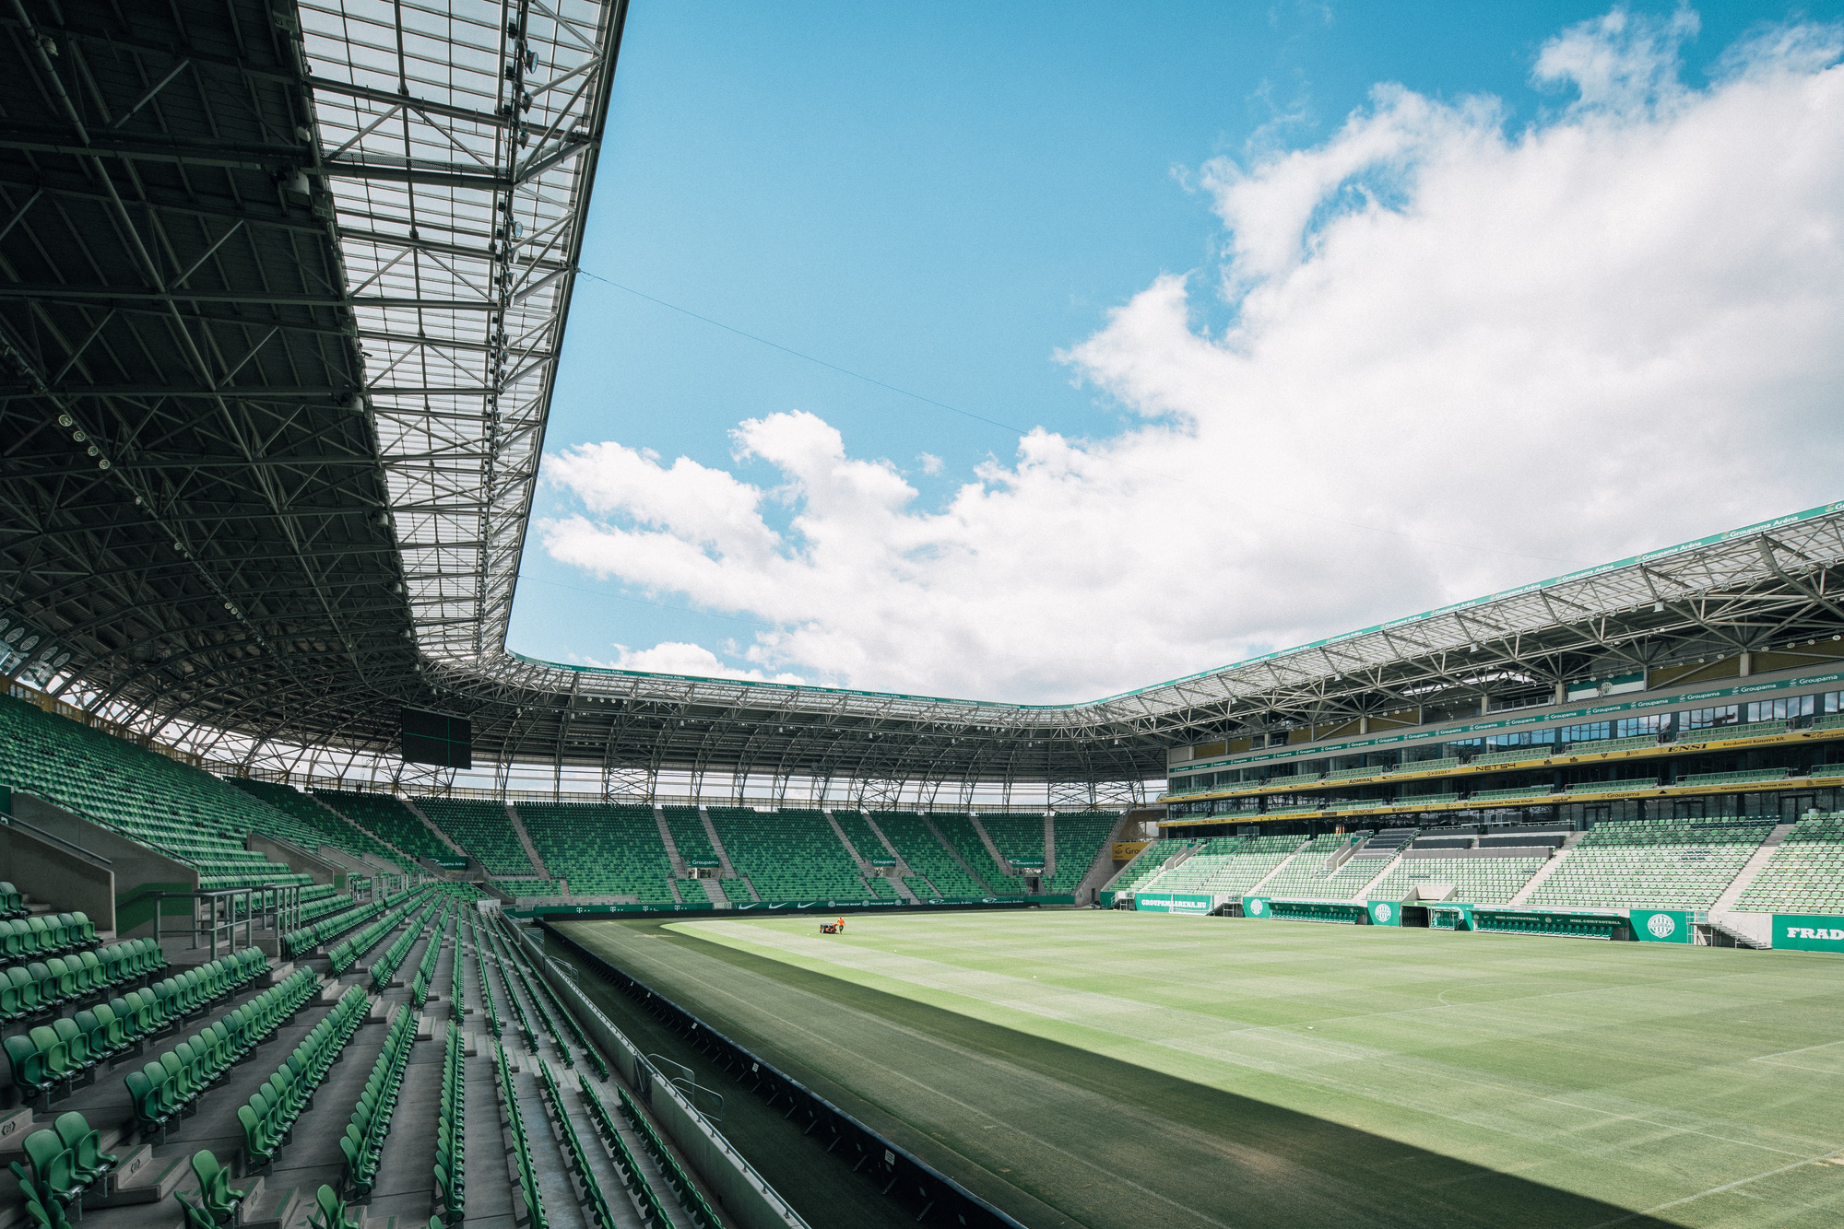

Sign up Sheet
Sports
Participant Name | Phone | Email | Sport
Start from 14:00 to 21:00
Sunday, May 19, 2030
Green Valley Sports Complex | 123 Park Avenue, Cityville

