Slide 1
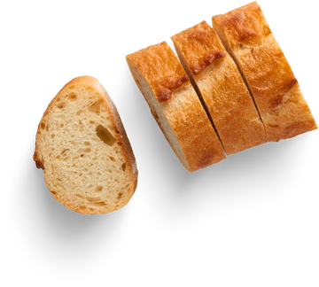


Bake Sale
MAY 27, 2024
9:00 am - 10:00 pm
Sign up Sheet
LOCATION: PANDAN BAKERY -
43 EXMOUTH MARKET, LONDON W1U 4PD, UNITED KINGDOM
NAME | PHONE | BAKED GOODS | QUANTITY | DIETARY RESTRICTIONS

