Slide 1
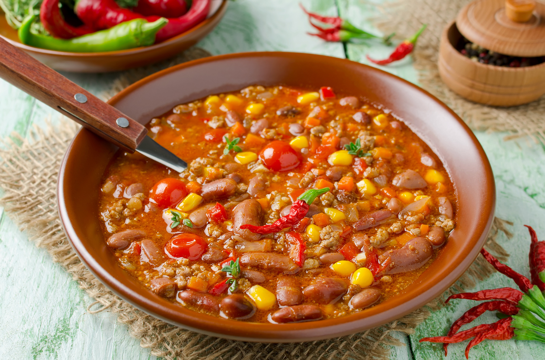

Sign up Sheet
Chili Cook Off
FULL NAME
PHONE
EMAIL
CHILI NAME
SATURDAY, NOVEMBER 4, 2028
4:00 PM - 8:00 PM
RED PEPPER PAVILION, 123 SPICE LANE, SAVORTOWN

