Slide 1
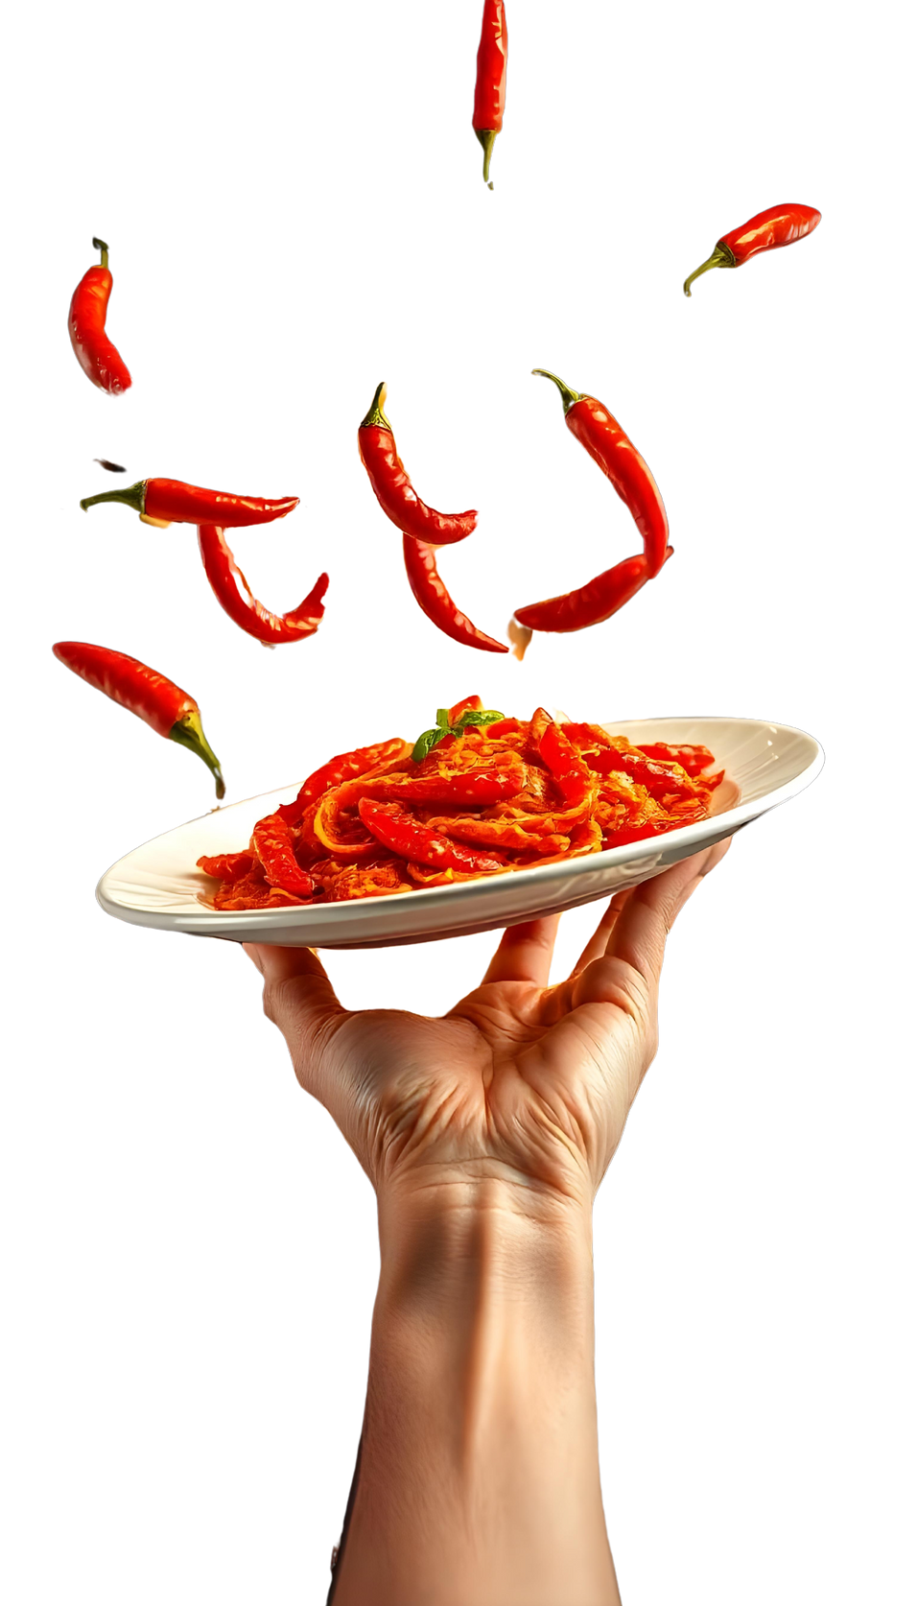






Chili
SIGN UP SHEET
Judge
Chef Sophia Marie
Chef Marina Red
Cook Off
SUNDAY
Dec
25
4PM—
8PM
Community Center Hall, 123 Main Street Hometown, USA
Full Name | Phone | Key Ingredients | Spice Level | Equipment Needed

