Slide 1

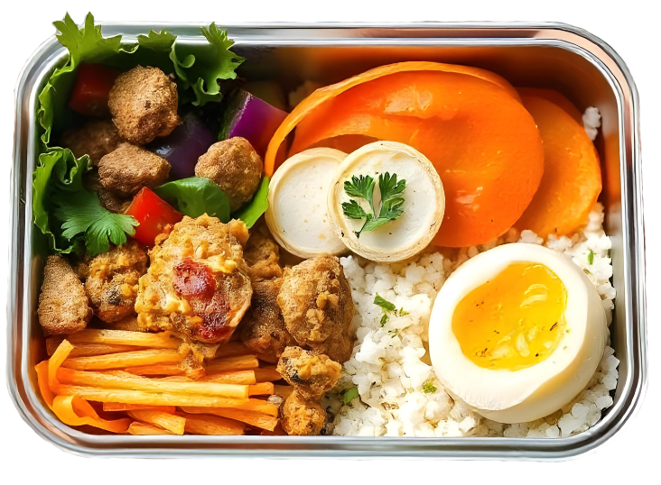

Lunch
Sign up Sheet
FULL NAME | PHONE | DISHES | QUANTITY
April 10, 2024
12:00 PM - 2:00 PM
Rooftop Garden, Skyline Tower, 15th Floor
Theme | International Cuisine Buffet

