Slide 1
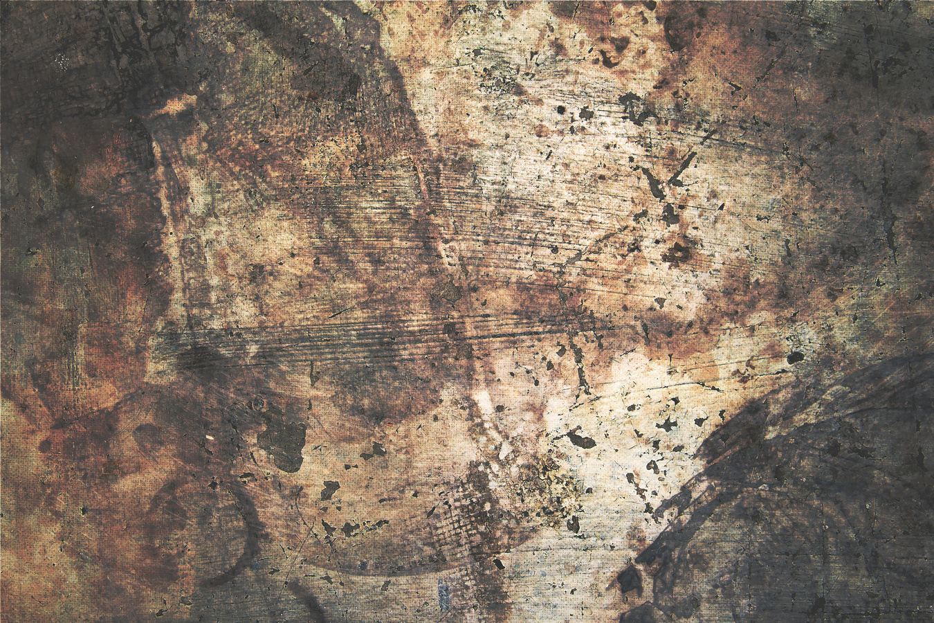




Military
Sign up Sheet
Training
Schedule
Review Process
Recruits must attend the
mandatory 8 weeks basic training
Your application will undergo review and be evaluated within 2 weeks
Full Name | Phone Number | Citizenship Status | Physical Fitness Level | Reason for Joining
Crimson Hawk Division | 457 Liberty Crest Avenue, Falcon Ridge District
Captain Marcus Steele | recruitment@crimsonhawkdivision.com

