Slide 1
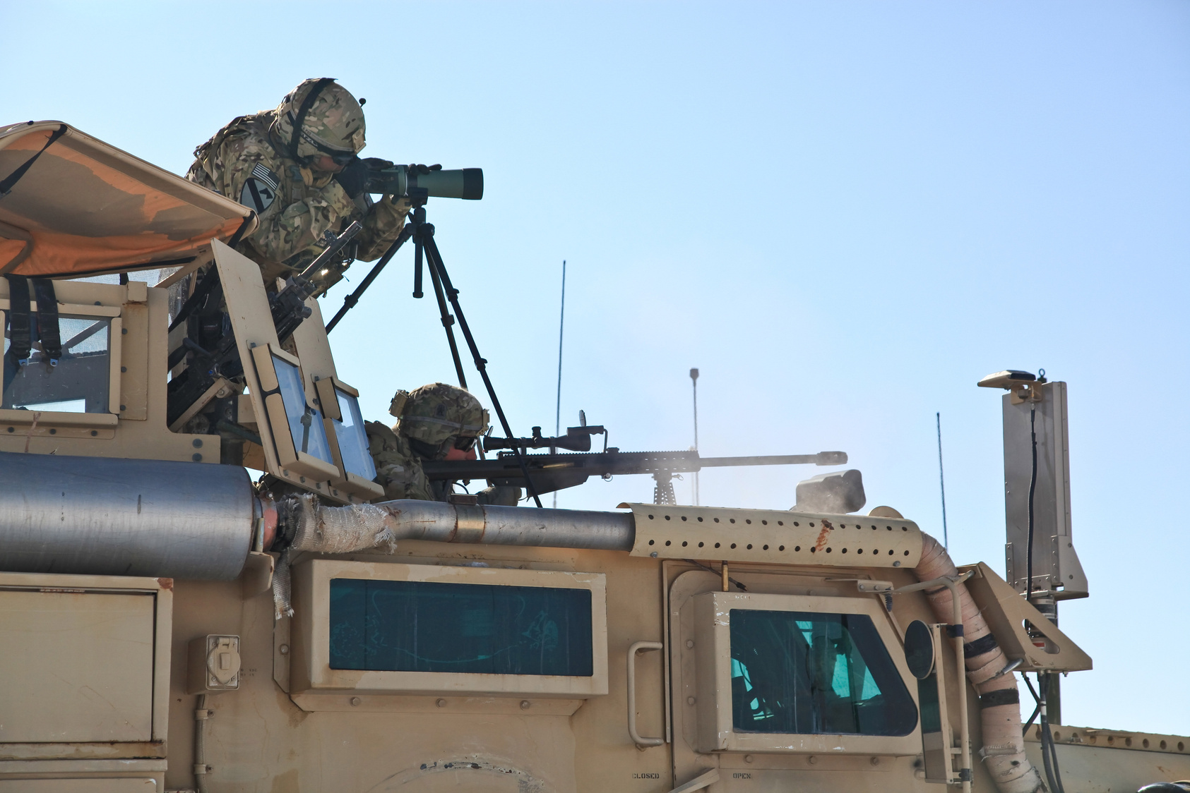


Sign up Sheet
Military
This Military Sign-Up Sheet is designed to collect necessary information for individuals interested in joining or participating in activities with the Crimson Hawk Division
Participant Name | Phone | Email | Citizenship
Captain Marcus Steele | +1 (555) 123-4567 | recruitment@crimsonhawkdivision.com
Crimson Hawk Division | 457 Liberty Crest Avenue, Falcon Ridge District, Sentinel City, TX 77301, United States

