Slide 1




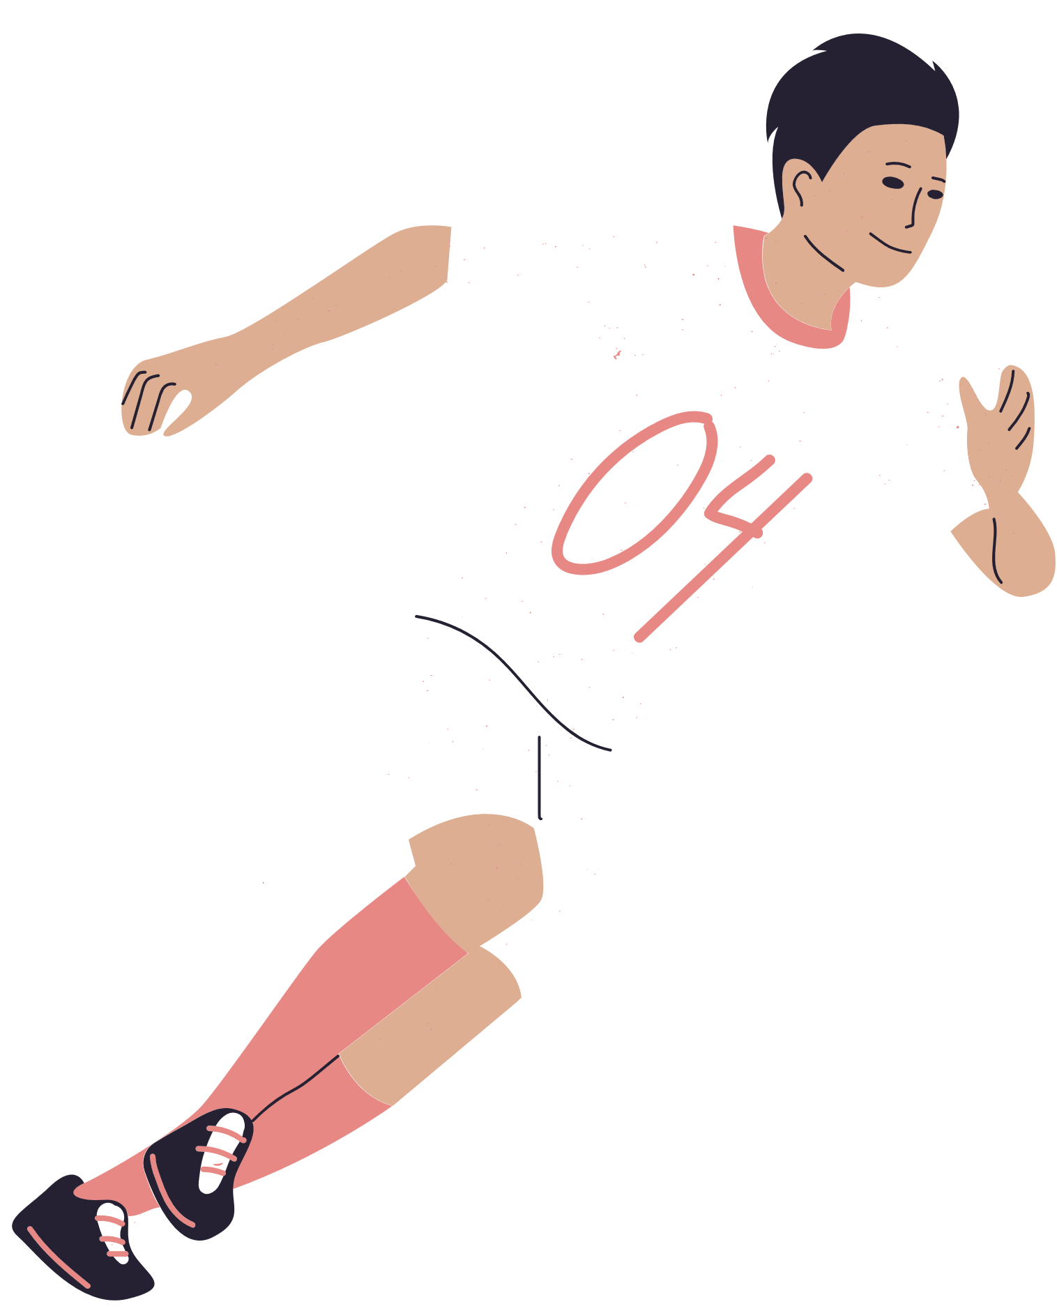







League Format
12-Team Redraft League
FANTASY
FOOTBALL
Match Style
Head-to-Head Matchups (weekly)
Participant Name | Phone | Email | Preferred Position | Entry Fee Paid
Playoff Schedule | December 10, 2024 – January 5, 2025
Primary Platform | ESPN Fantasy App (accessible via mobile or desktop)

