Slide 1
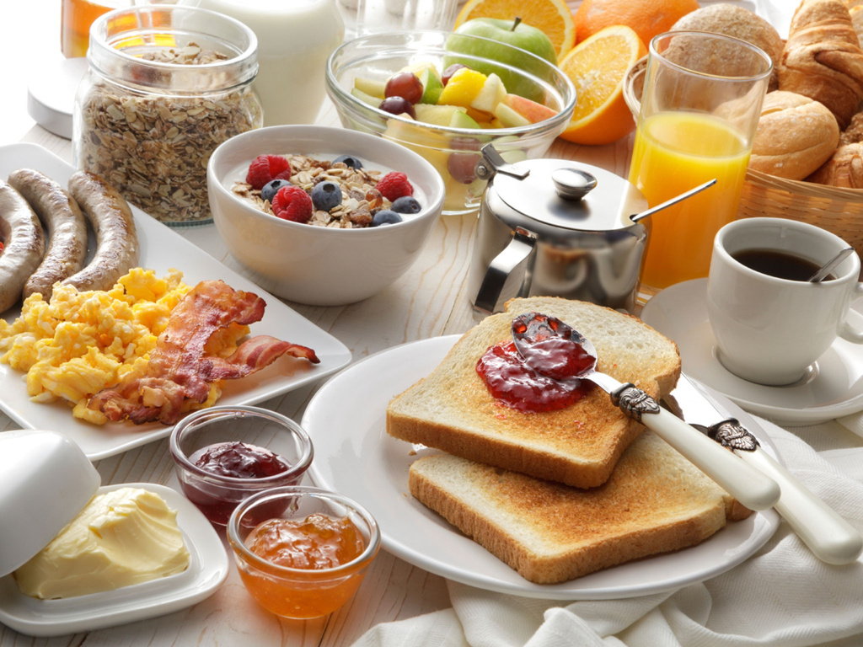

Breakfast
SIGN UP SHEET
potluck
25/12
4 PM
with Chef
Sophia Marie
Full name
Phone
I am bringing
Sunnyvale Community Hall | 145 Brookside Avenue, Sunnyvale, CA 94086
Emily Turner (Organizer) | +123-456-7890

