Slide 1
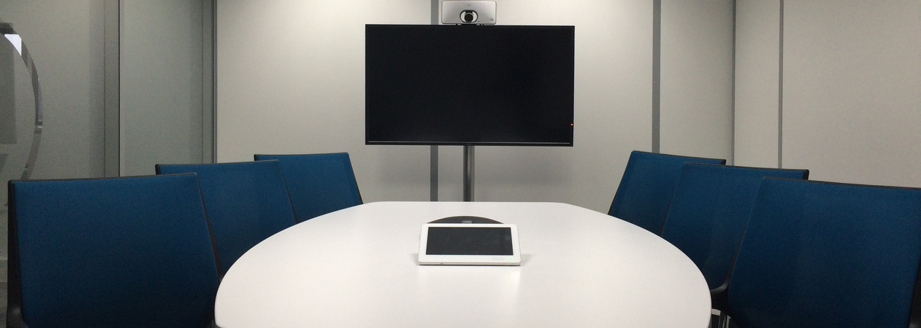

Sign up Sheet
Conference Room
Organizer's Name | Phone | Email | Date
Hotline
Email
Skyline Tower Conference Room
+123-456-7890
Skylinetowerconferenceroom.com
24th Floor, 125 Horizon Avenue, New City, NC 02911

