Slide 1
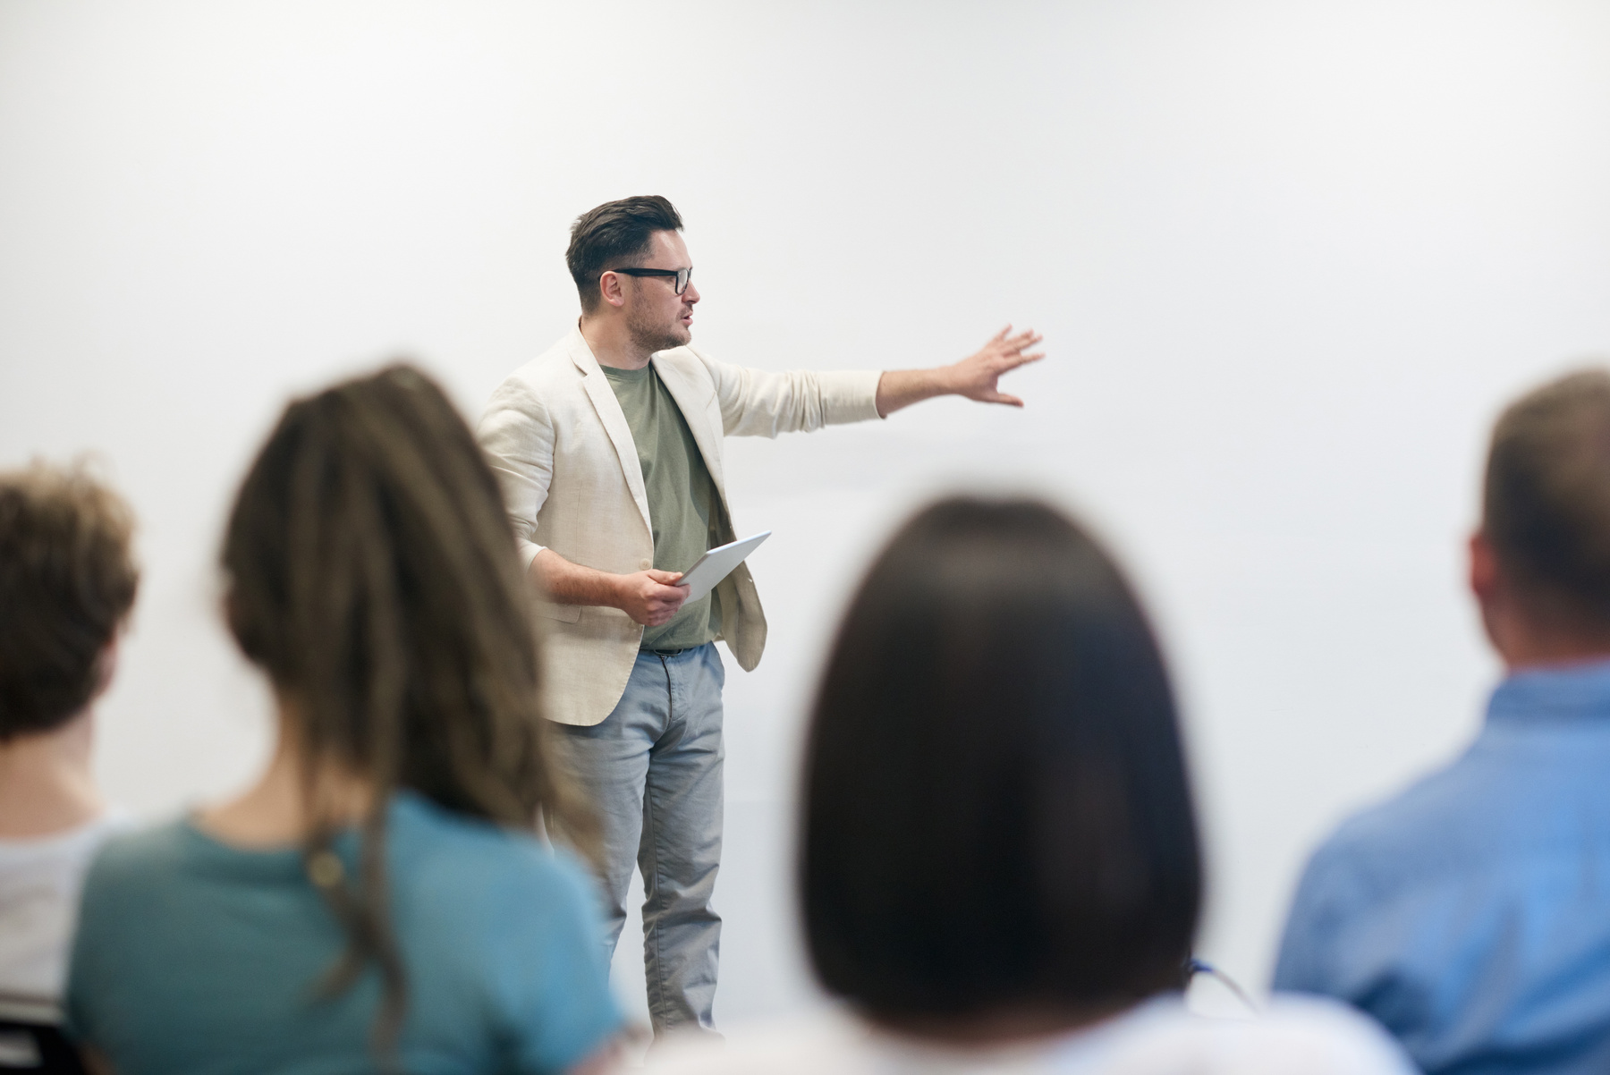

SIGN UP SHEET
Parent Teacher Conference
Parent's Name | Phone | Email | Available Time
DECEMBER 29, 2024 | STAR FROM 9 AM
TEACHER.MARIANA@SCHOOLMAIL.EDU
MARIANA| (555) 123-4567

