Slide 1
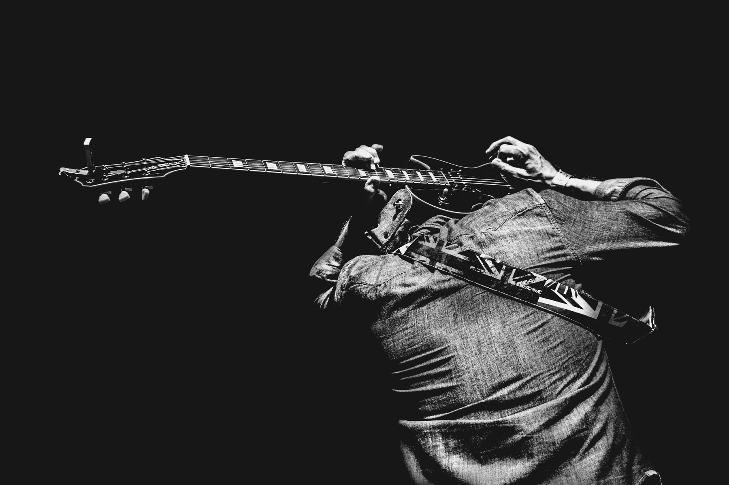







TALENT SHOW
Time & Date
Location
6.30 p.m. 21.10.2027
Starlight Theater - 23 Anywhere St., Any City
Name
Phone
Email
Performance
Category
Name
Phone
Email
Performance
Category
Name
Phone
Email
Performance
Category
Name
Phone
Email
Performance
Category
Name
Phone
Email
Performance
Category
Name
Phone
Email
Performance
Category
Name
Phone
Email
Performance
Category

