Slide 1
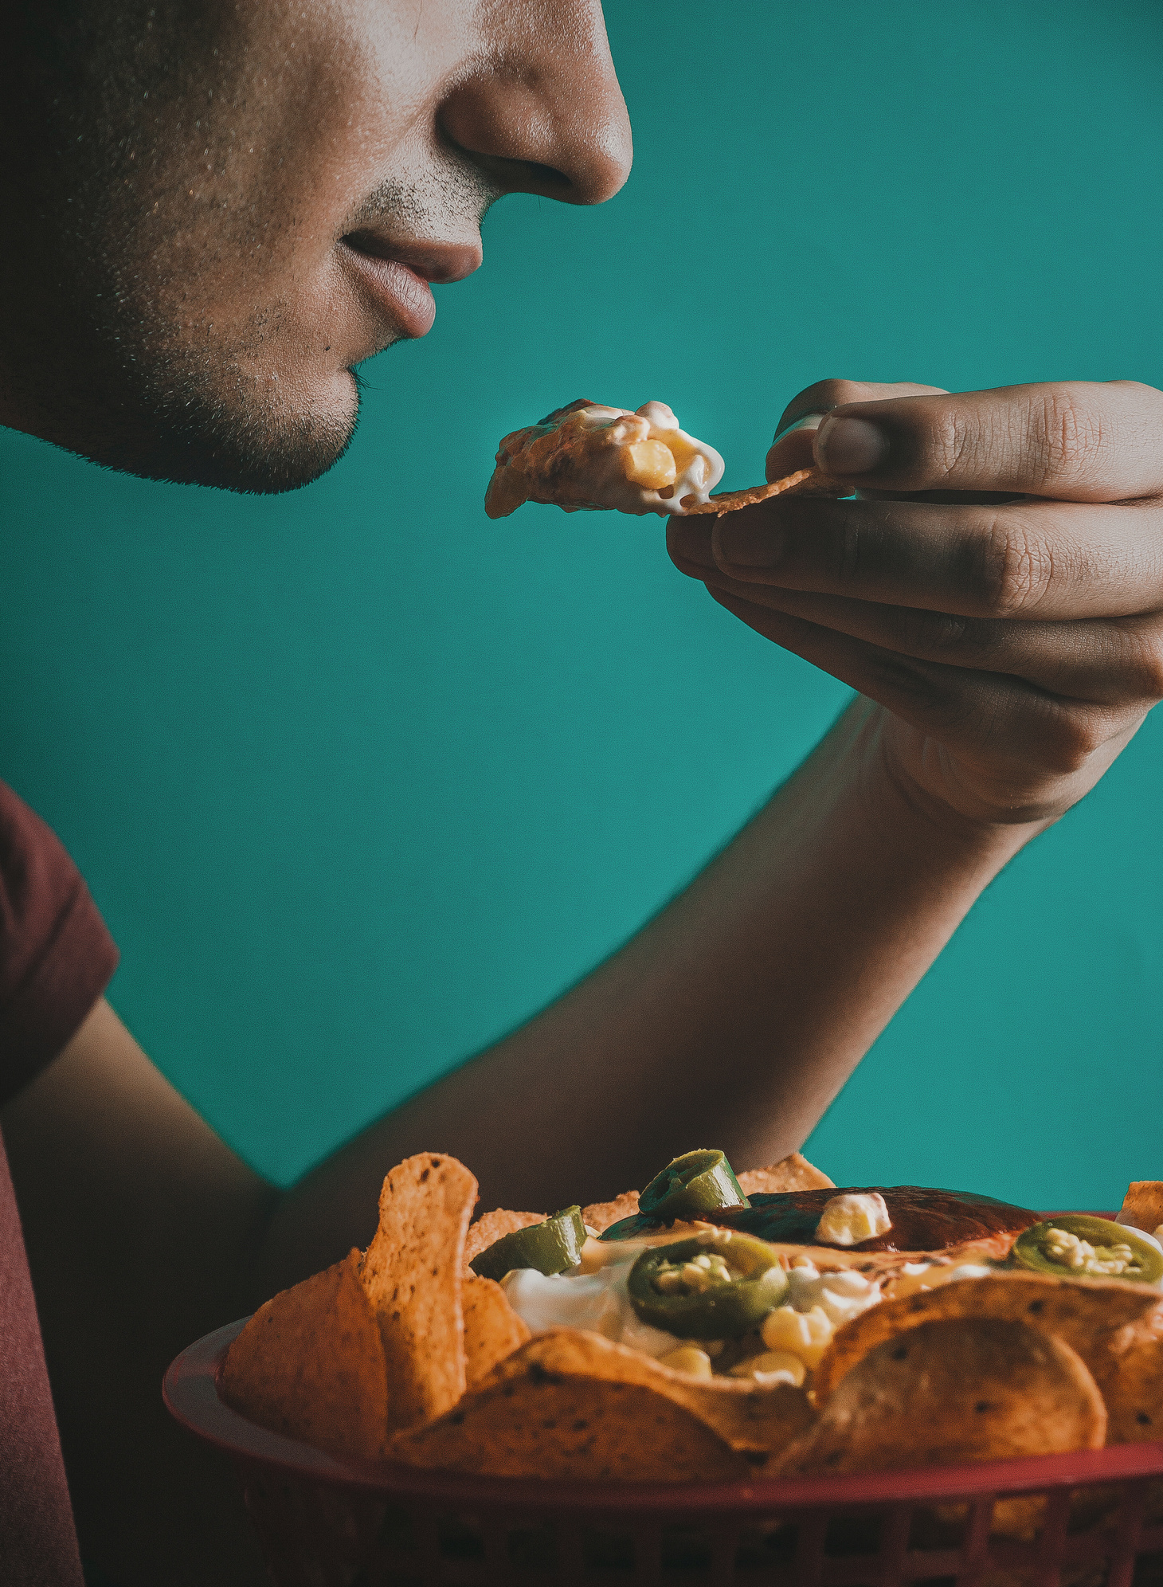


Life is like a plate of nachos - sometimes a little messy, but with the right toppings, it’s always a delicious adventure!
LUCY’S HOME
Sep 15
16:00 - 20:00
Nacho Bar
SIGN UP SHEET
Full Name | Phone | Will Bring | Quantity | Note
Lucy’s home | 123 Anywhere St., Any City
+123-456-789 | Lucy Green - Host

