Slide 1
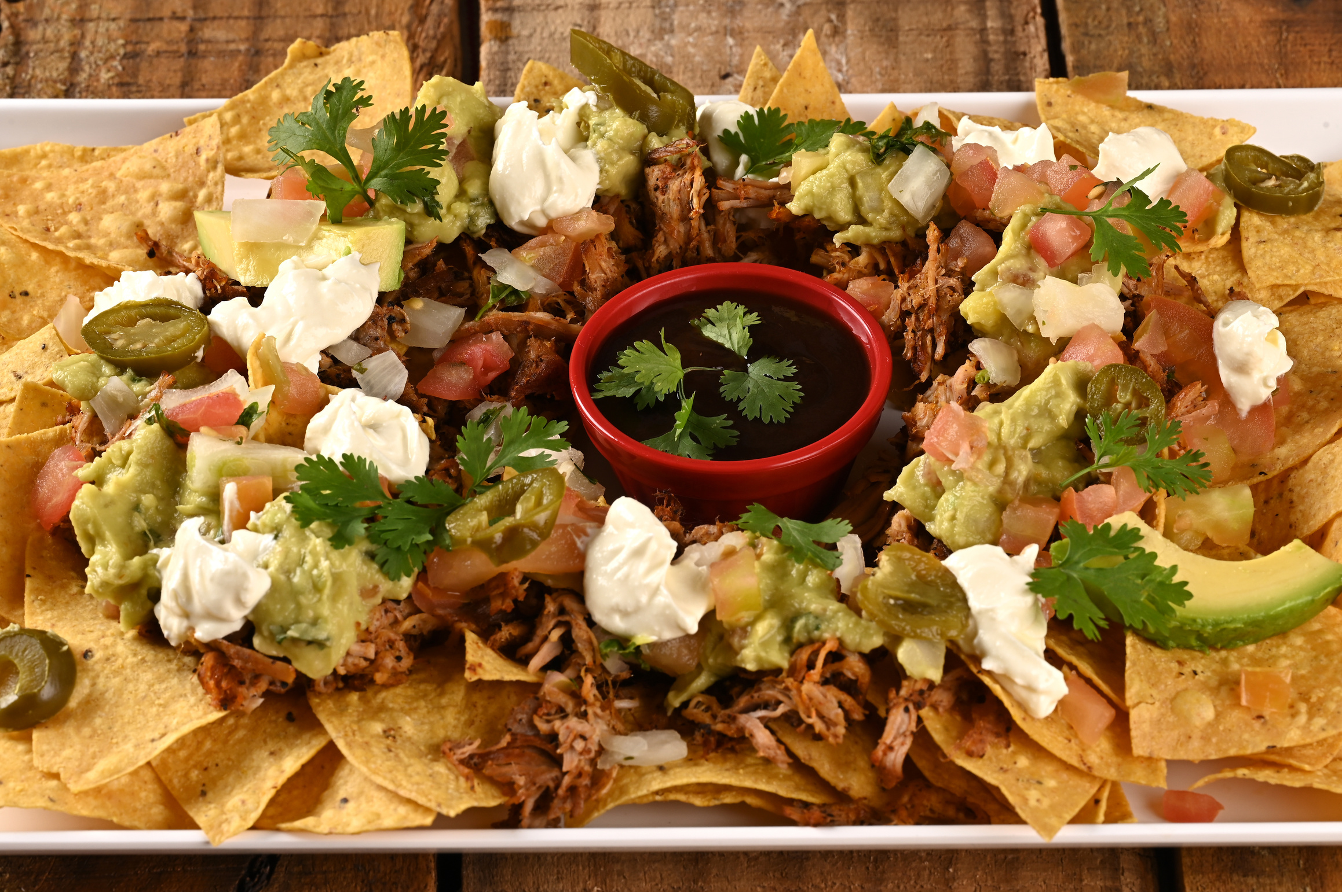

Community Center Hall, 123 Main Street
Start at
10:00 AM
NACHO BAR
01.04.2030
SIGN UP SHEET
FULL NAME
PHONE
WILL BRING

