Slide 1
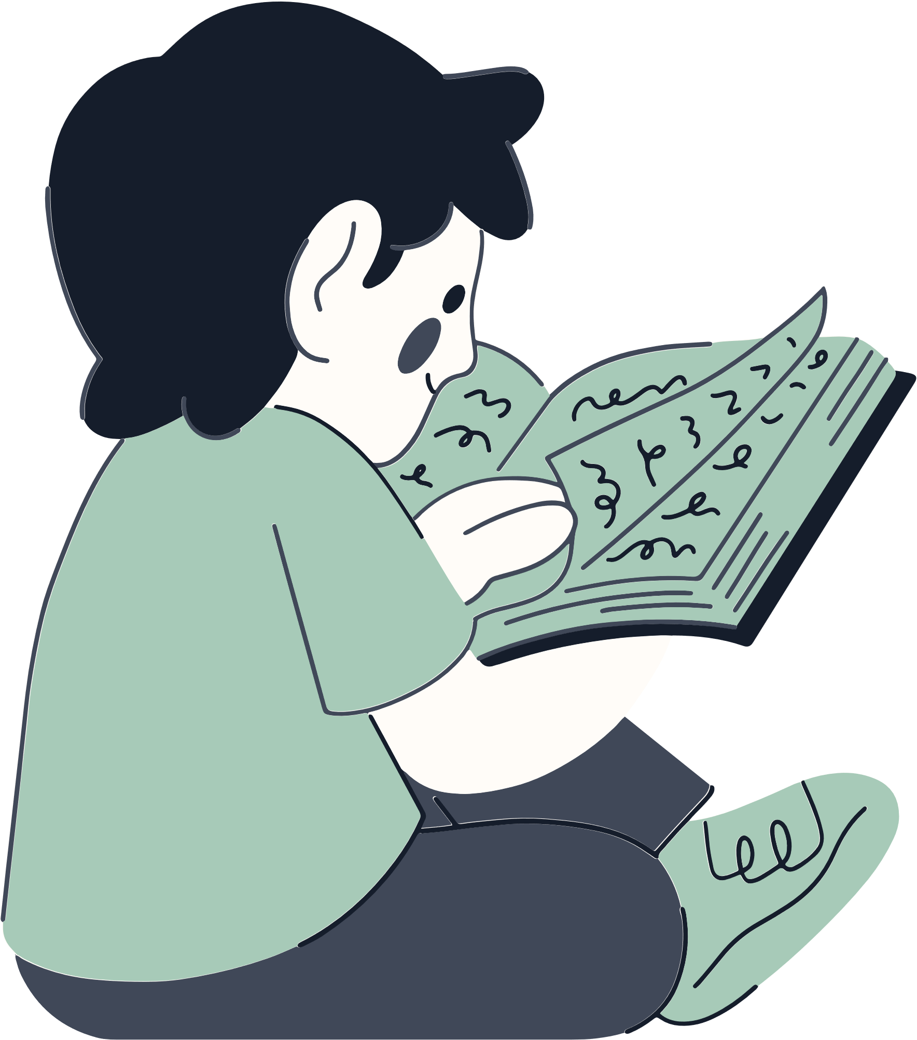



Sign up sheet
Mystery reader
Teacher - Mr. Smith | +123-456-7890
Grade - 2nd Grade | Class 2C
Room - 202 | 2nd Floor
Child’s Name
Mystery Reader’s Name
Phone
Book Title
Date
Time Slot
Child’s Name
Mystery Reader’s Name
Phone
Book Title
Date
Time Slot
Child’s Name
Mystery Reader’s Name
Phone
Book Title
Date
Time Slot
Child’s Name
Mystery Reader’s Name
Phone
Book Title
Date
Time Slot
Child’s Name
Mystery Reader’s Name
Phone
Book Title
Date
Time Slot
Special Instructions
Please arrive 10 minutes early to check in at the office
Reading sessions should last about 20-30 minutes

