Slide 1
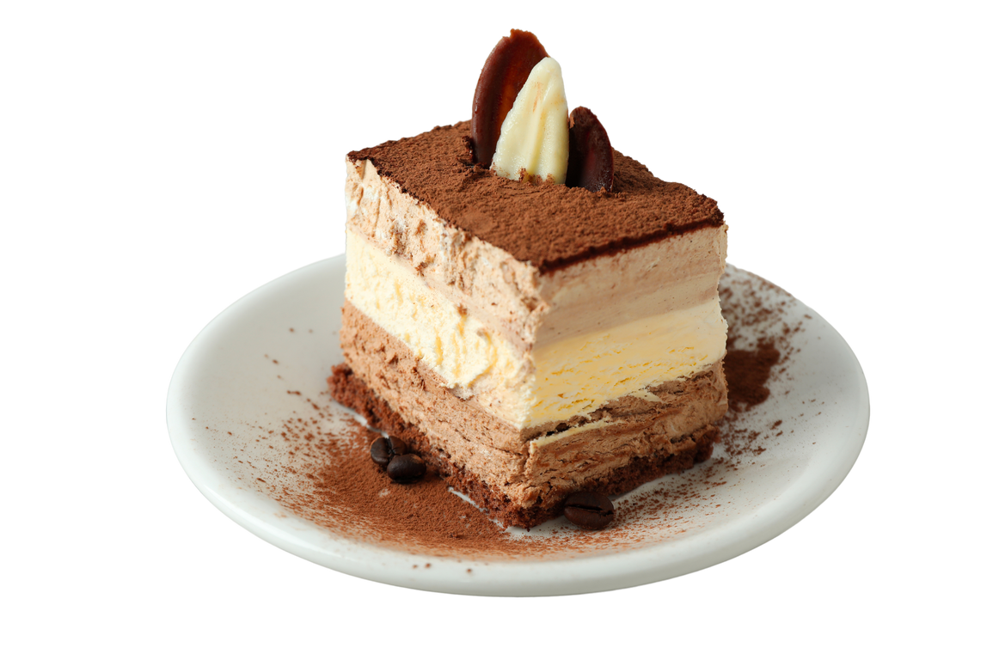
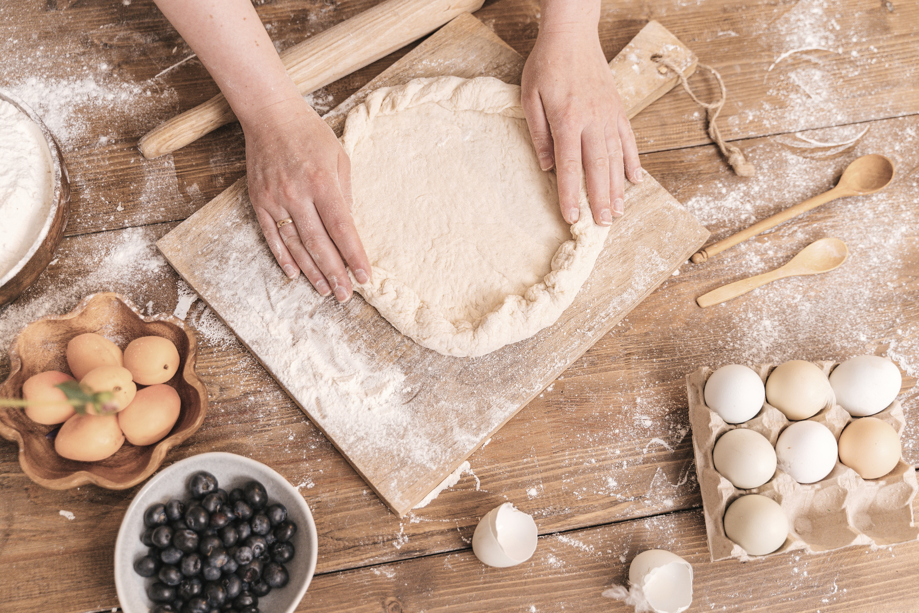

Dessert
FROM CAKES TO COOKIES, PIES TO PUDDINGS, LET'S FILL THIS TABLE WITH DELECTABLE DELIGHTS! SIGN UP TO CONTRIBUTE YOUR DESSERT MASTERPIECE.
sign up
sheet
22 AUGUST
09:00 - 21:00
Pandan House - 23 Anywhere St., Any City
Name
Phone
Dessert
Quantity
Note

