Slide 1

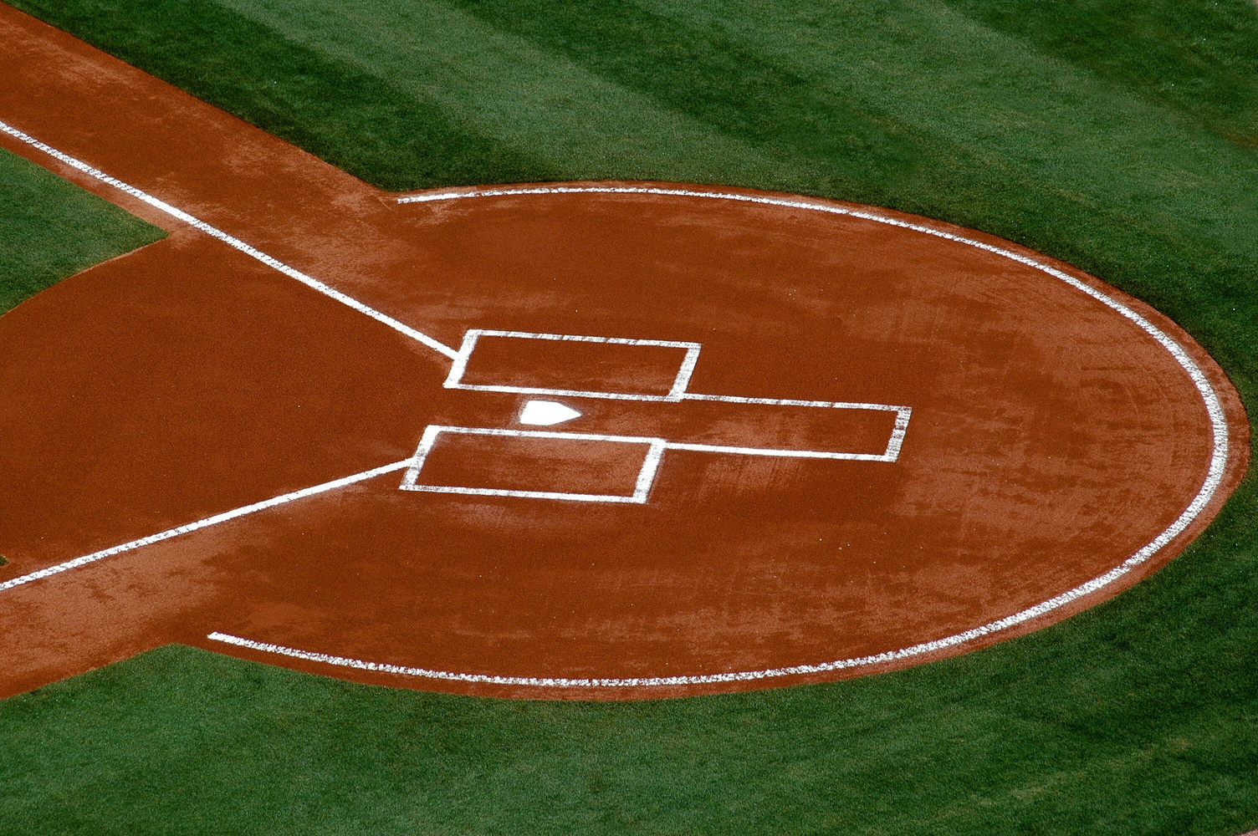

Sign Up Sheet
$30
Baseball
million
Grand Prize
Player Name | Phone | Age | Position | Shirt Size
Time
Date
Location
5:00 PM - 7:30 PM
Saturday, April 13, 2030
Grandview Stadium, Field 2 | 456 Grandview Avenue, Metro City

