Slide 1
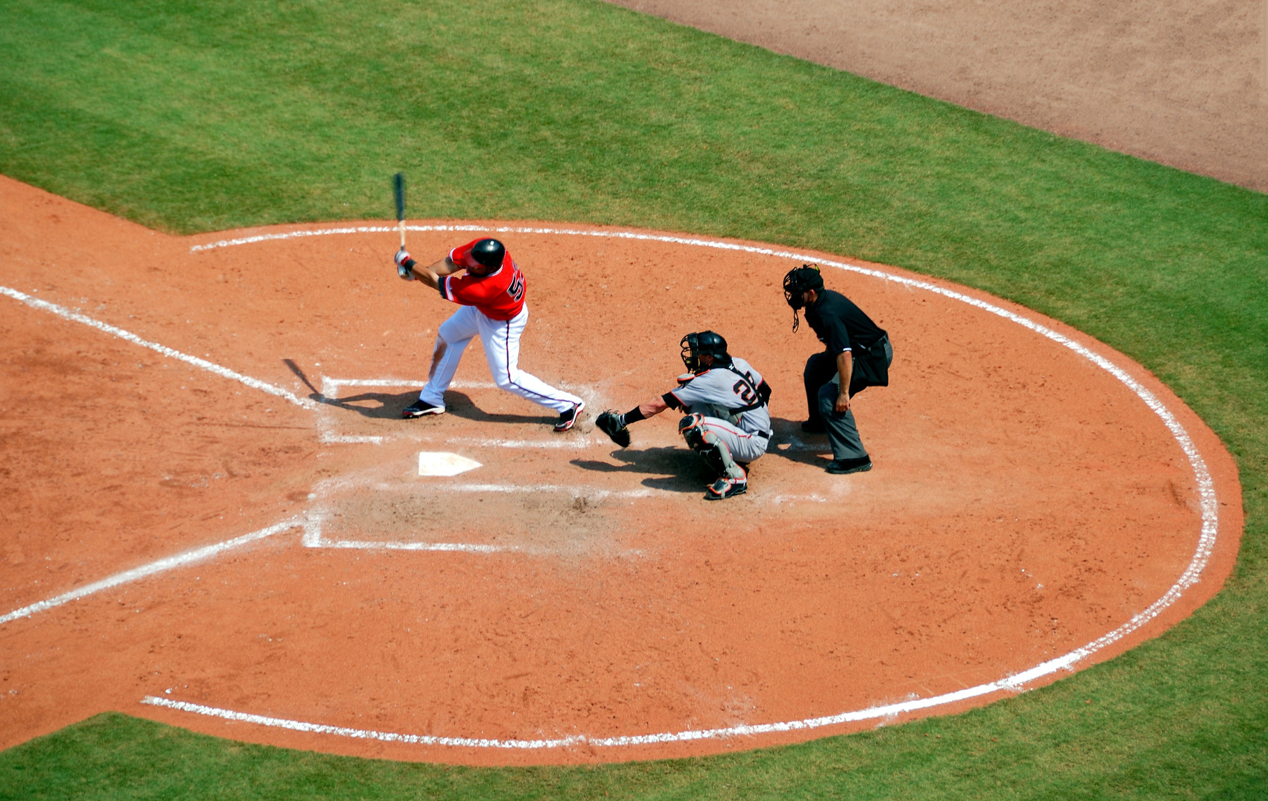

Sign up Sheet
Baseball
Player Name | Phone | Email | Position
Time
Date
Location
5:00 PM - 7:30 PM
Saturday, April 13, 2030
Riverside Sports Complex, Field 3

