Slide 1

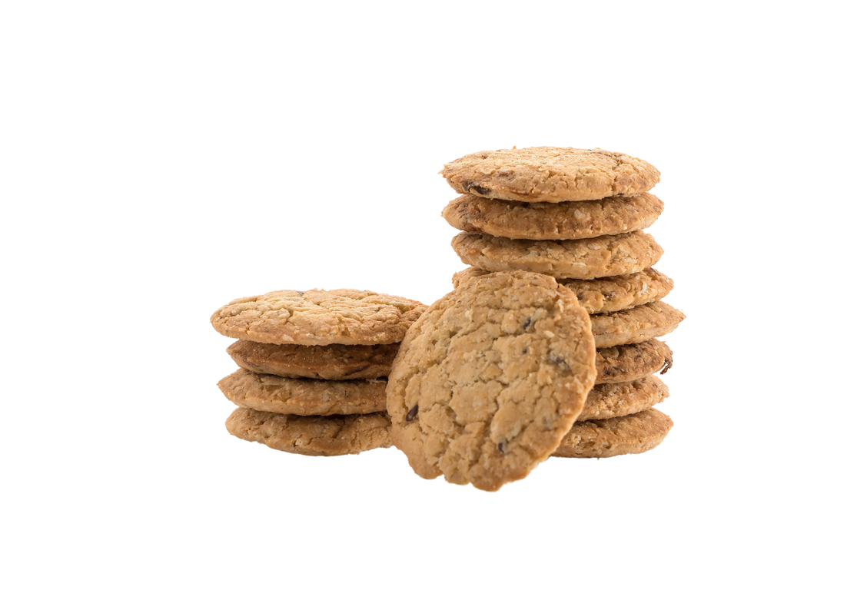


Sign up Sheet
COOKIE
EXCHANGE
Time
Date
Location
This sign-up sheet ensures a variety of cookies and avoids duplicates. Please fill in your cookie type, any special ingredients, and the quantity you'll bring.
3:00 PM
– 6:00 PM
Sunday,
Nov 19, 2025
Harvest Creek Community Center
Full Name | Phone | Email | Cookie Name | Allergies

