Slide 1

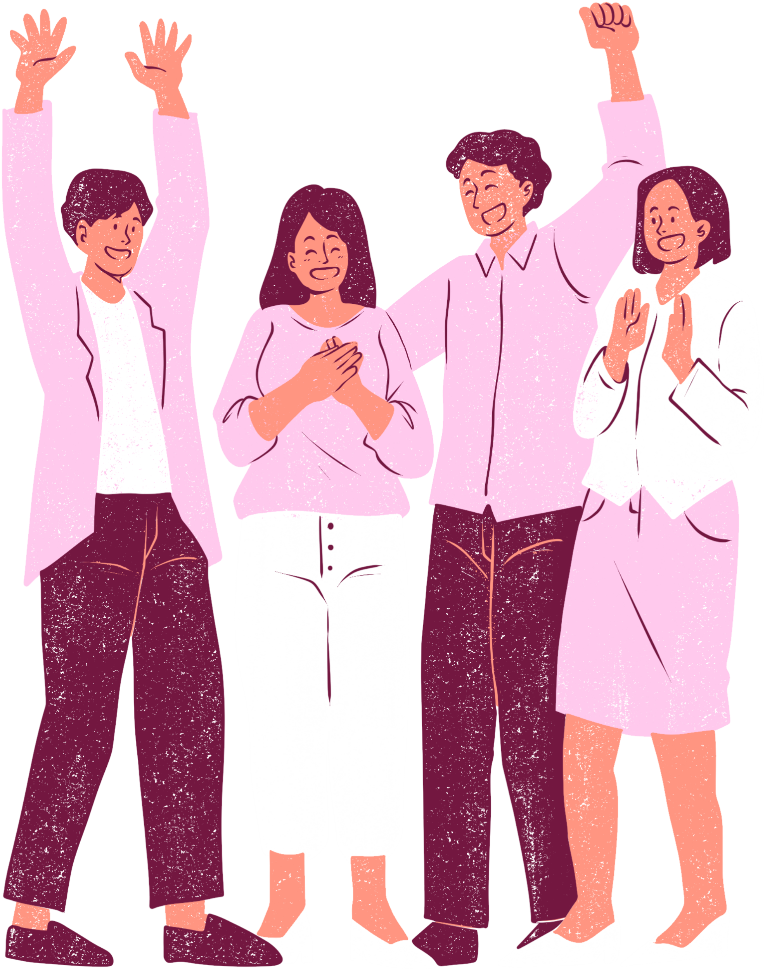


Sign up Sheet
Farewell
potluck
22 NOV
PANTRY ROOM | 06:00 PM - 9:00 PM
FULL NAME
PHONE
EMAIL
I AM BRINGING

