Slide 1


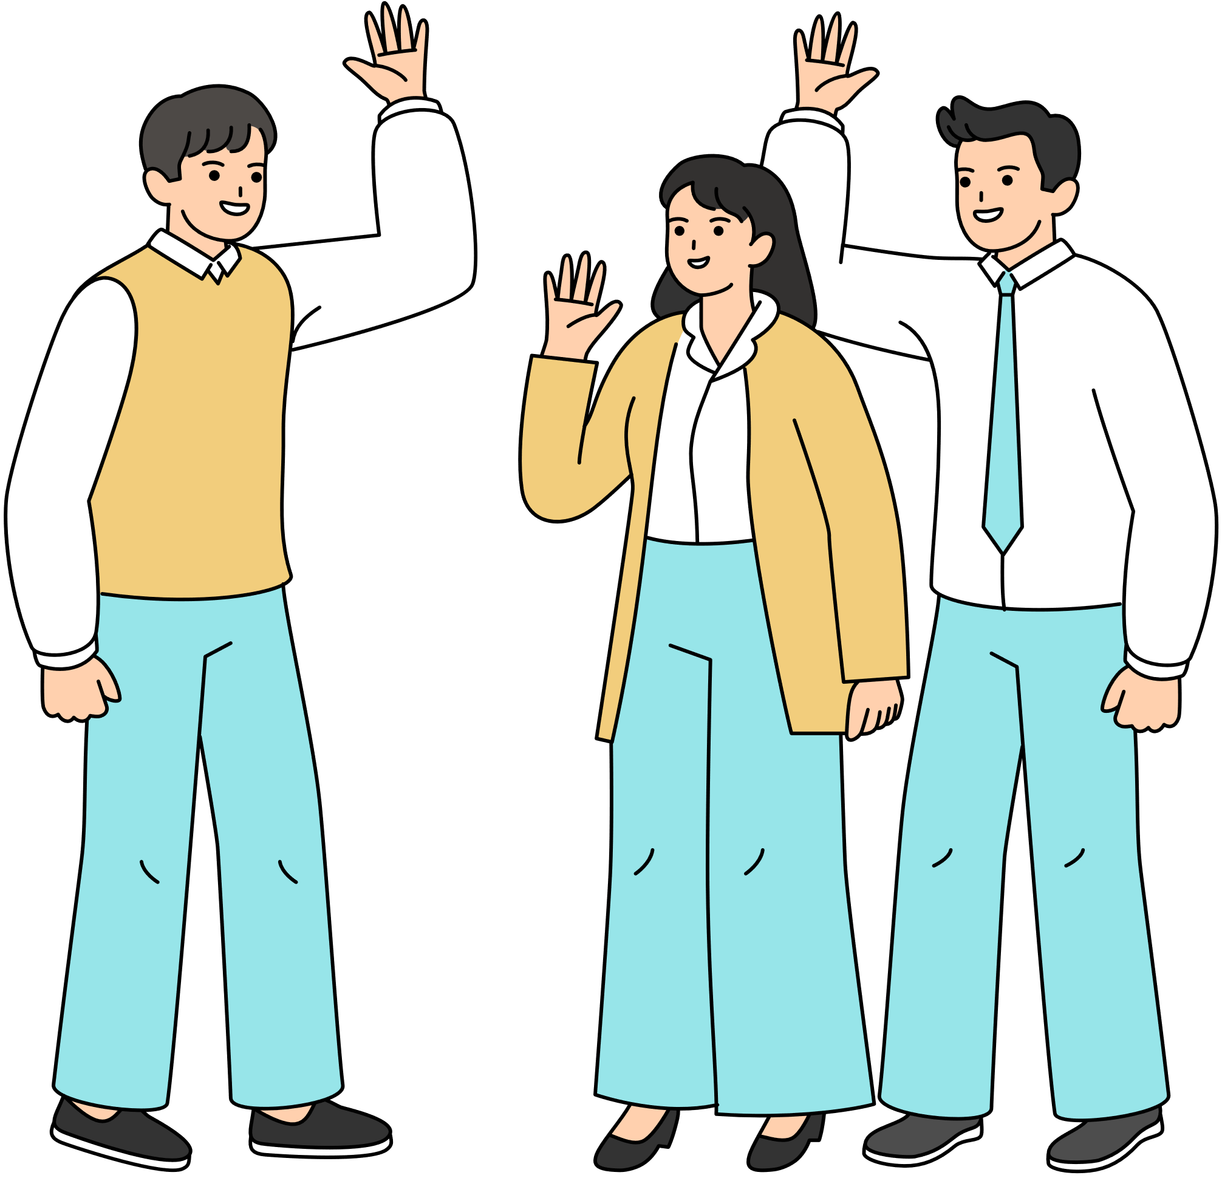

Farewell
Sign up Sheet
Jennie’s House
123 Main Street Hometown, USA
25/04
12 PM
Don’t miss out
on all the fun and excitement—be sure to arrive on time!
Full Name | Phone | Will Bring | Quantity

