Slide 1

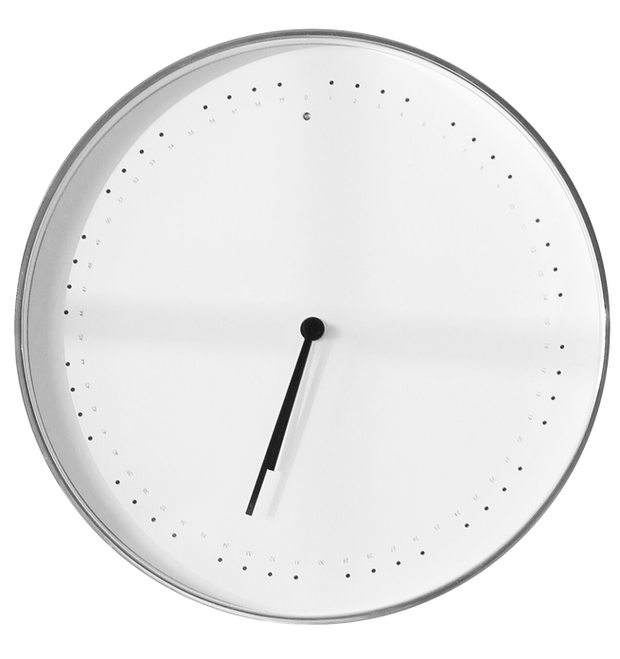



Overtime
sign up sheet
Requirements
Benefits
Approval Required
Overtime Pay
Overtime must be approved by the direct manager before signing up
Overtime hours are compensated at 1.5 times the regular hourly rate
Time Limit
Compensatory Time
Overtime is limited to a maximum of 12 hours per day and 40 hours per month
Extra hours worked can earn compensatory time off (CTO) for future use
Employee Name | Phone | Email | Overtime Date | Reason for Overtime
Stellar Innovations Inc | 1234 Horizon Blvd, Suite 567, San Francisco, CA 94105, USA
Email | contact@stellarinnovations.com

