Slide 1
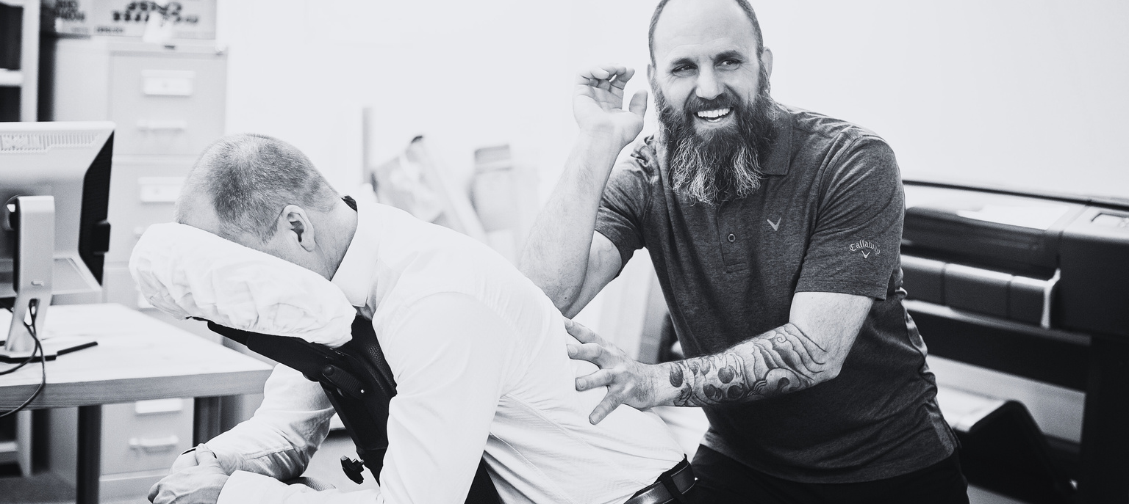

Chair massage
Sign up sheet.
Name
Phone
Email
Preferred Time Slot
Duration of Massage
30 minutes
60 minutes
90 minutes
120 minutes
Allergies (if any)
Preferred Pressure
Light
Medium
Deep
Name
Phone
Email
Preferred Time Slot
Duration of Massage
30 minutes
60 minutes
90 minutes
120 minutes
Allergies (if any)
Preferred Pressure
Light
Medium
Deep
Name
Phone
Email
Preferred Time Slot
Duration of Massage
30 minutes
60 minutes
90 minutes
120 minutes
Allergies (if any)
Preferred Pressure
Light
Medium
Deep
Name
Phone
Email
Preferred Time Slot
Duration of Massage
30 minutes
60 minutes
90 minutes
120 minutes
Allergies (if any)
Preferred Pressure
Light
Medium
Deep
Name
Phone
Email
Preferred Time Slot
Duration of Massage
30 minutes
60 minutes
90 minutes
120 minutes
Allergies (if any)
Preferred Pressure
Light
Medium
Deep

