Slide 1

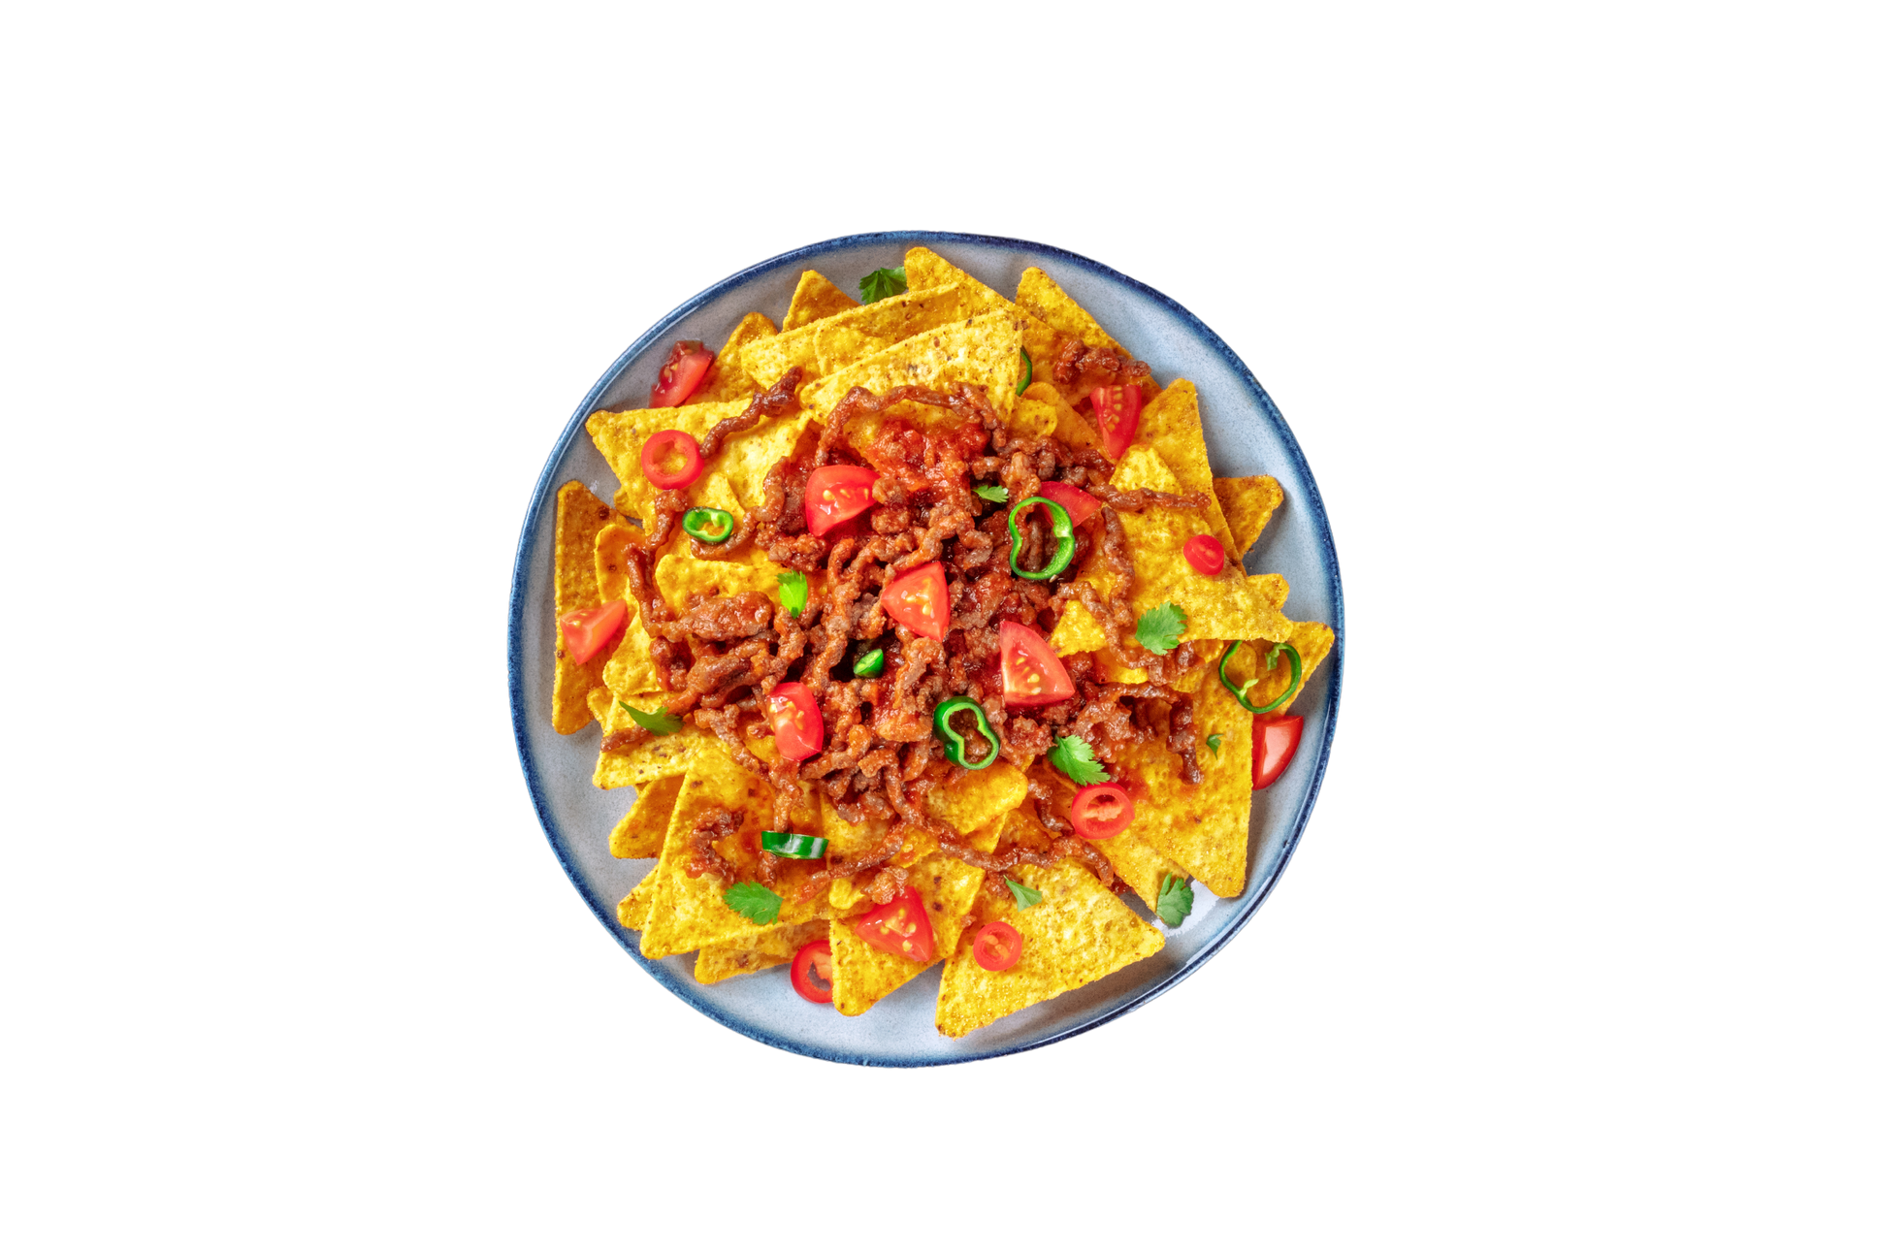
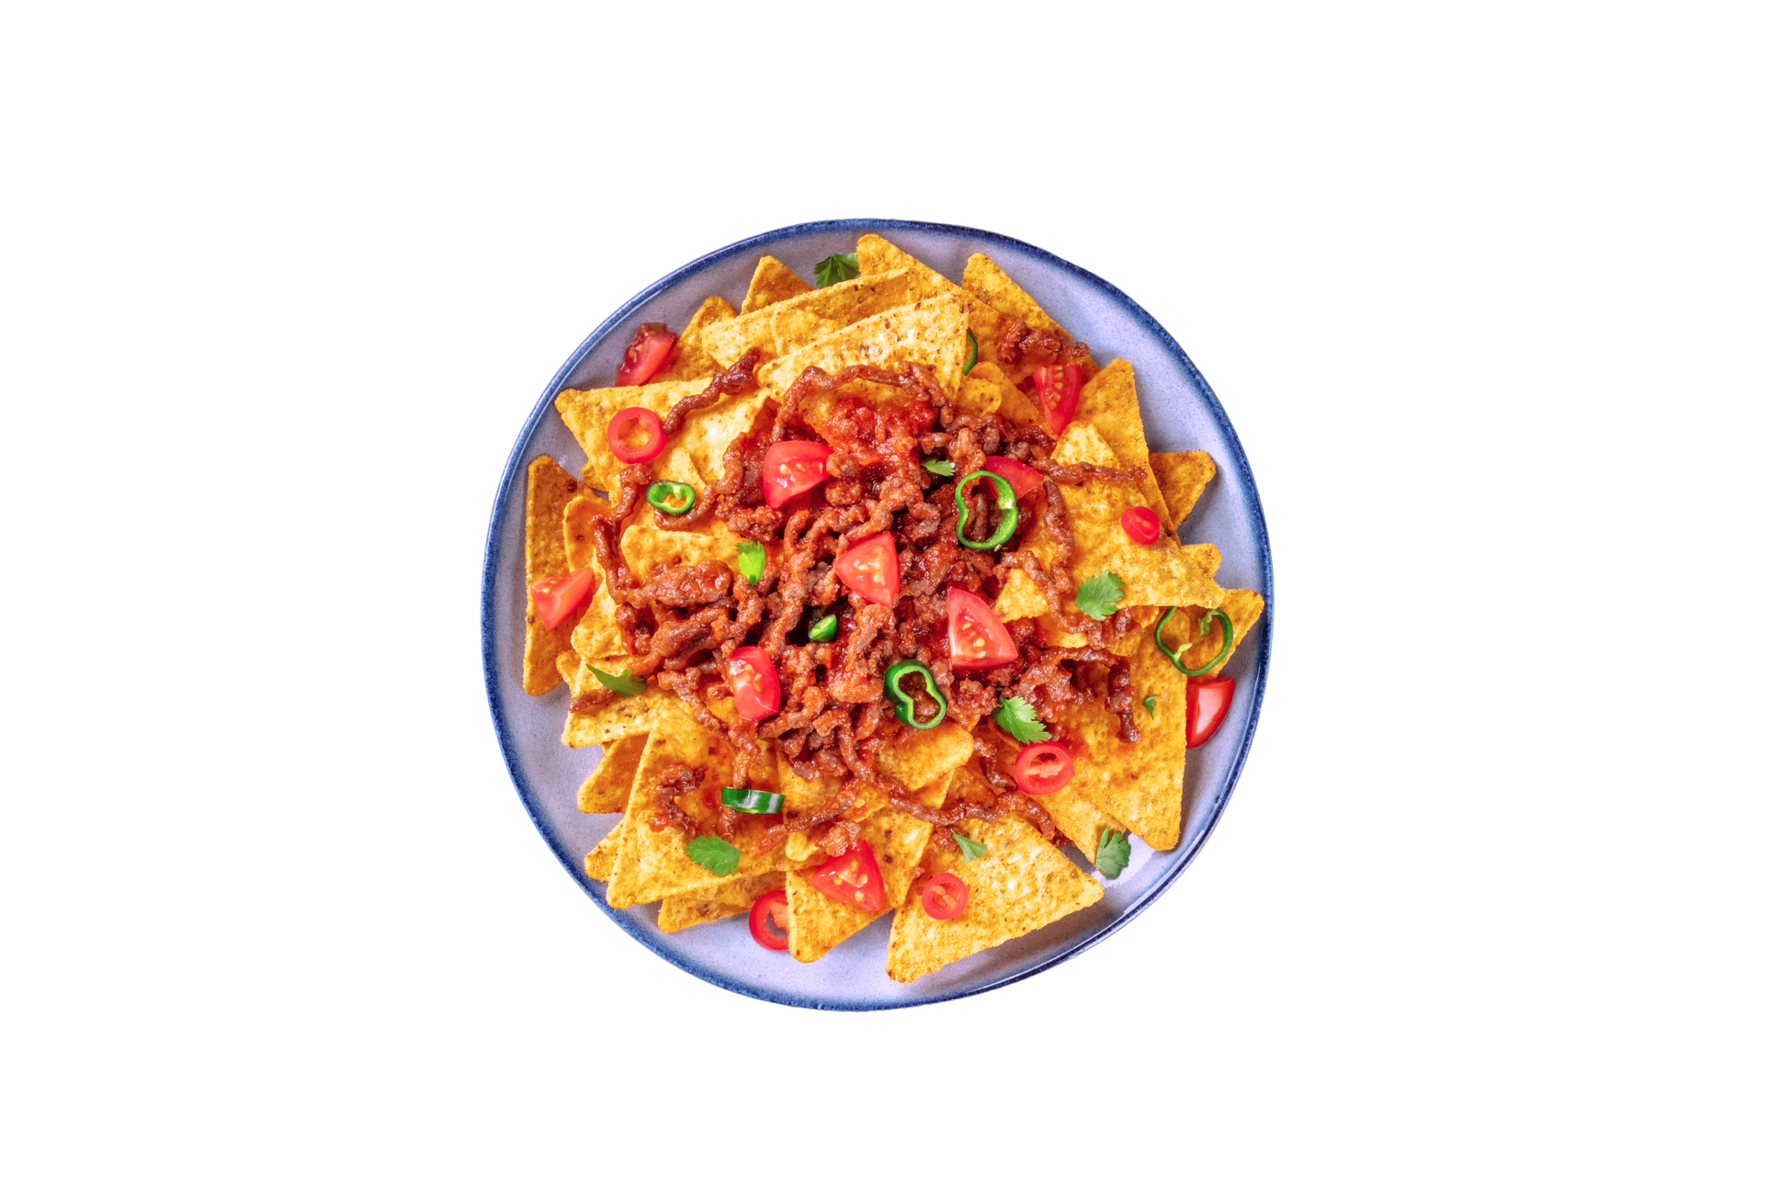


Mexican
Sign up Sheet
Time
Date
3:00 PM
– 8:00 PM
September 16, 2030
Full Name | Phone Number | Email | Item to Bring | Portion Size
The Lively Piñata Venue
Location
With Chef
Aurelya Moonvale

