Slide 1
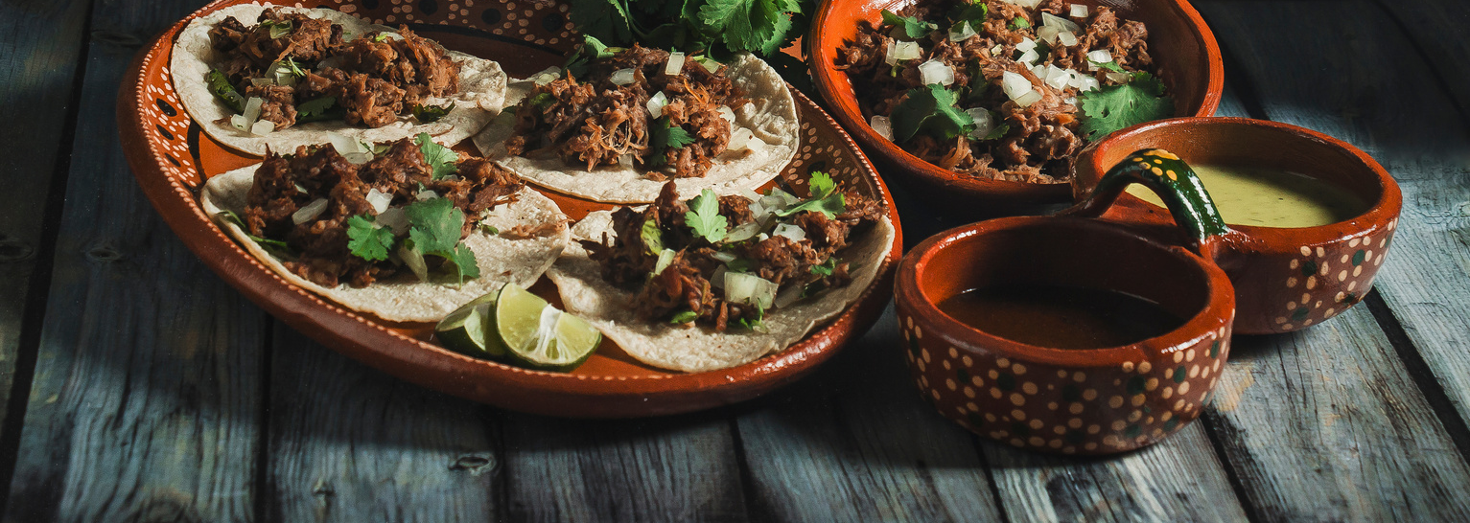

Sign up Sheet
Mexican
Potluck
Full Name | Phone | Will Bring
Start from 02.00 pm - 7.00 pm
5 May 2023
Casa Fiesta Hall | 125 Avenida del Sol, Pueblo Bonito, Texas

