Slide 1


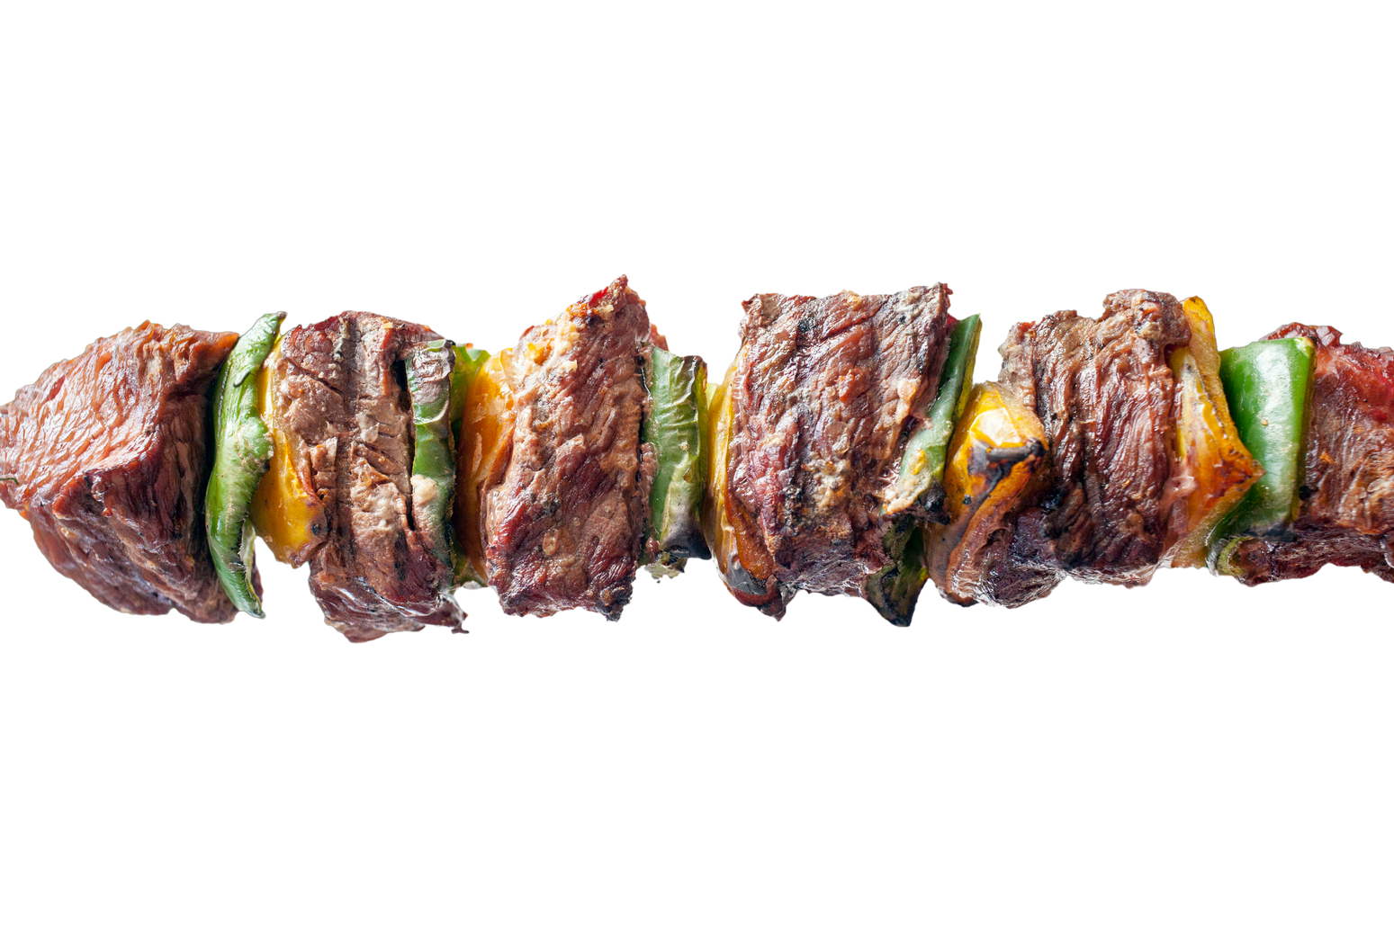

BBQ
SIGN UP SHEET
Nov
SUNDAY
10
15PM
18PM
POTLUCK
Greenwood Park Pavilion Area | 123 Anywhere St., 123 Any City
Full Name | Phone | Food Categories | Dishes | Quantity
Greenwood Park Pavilion Area | 123 Anywhere St., Any City
+123-456-789 | Jane Doe - BBQ Organizer

