Slide 1
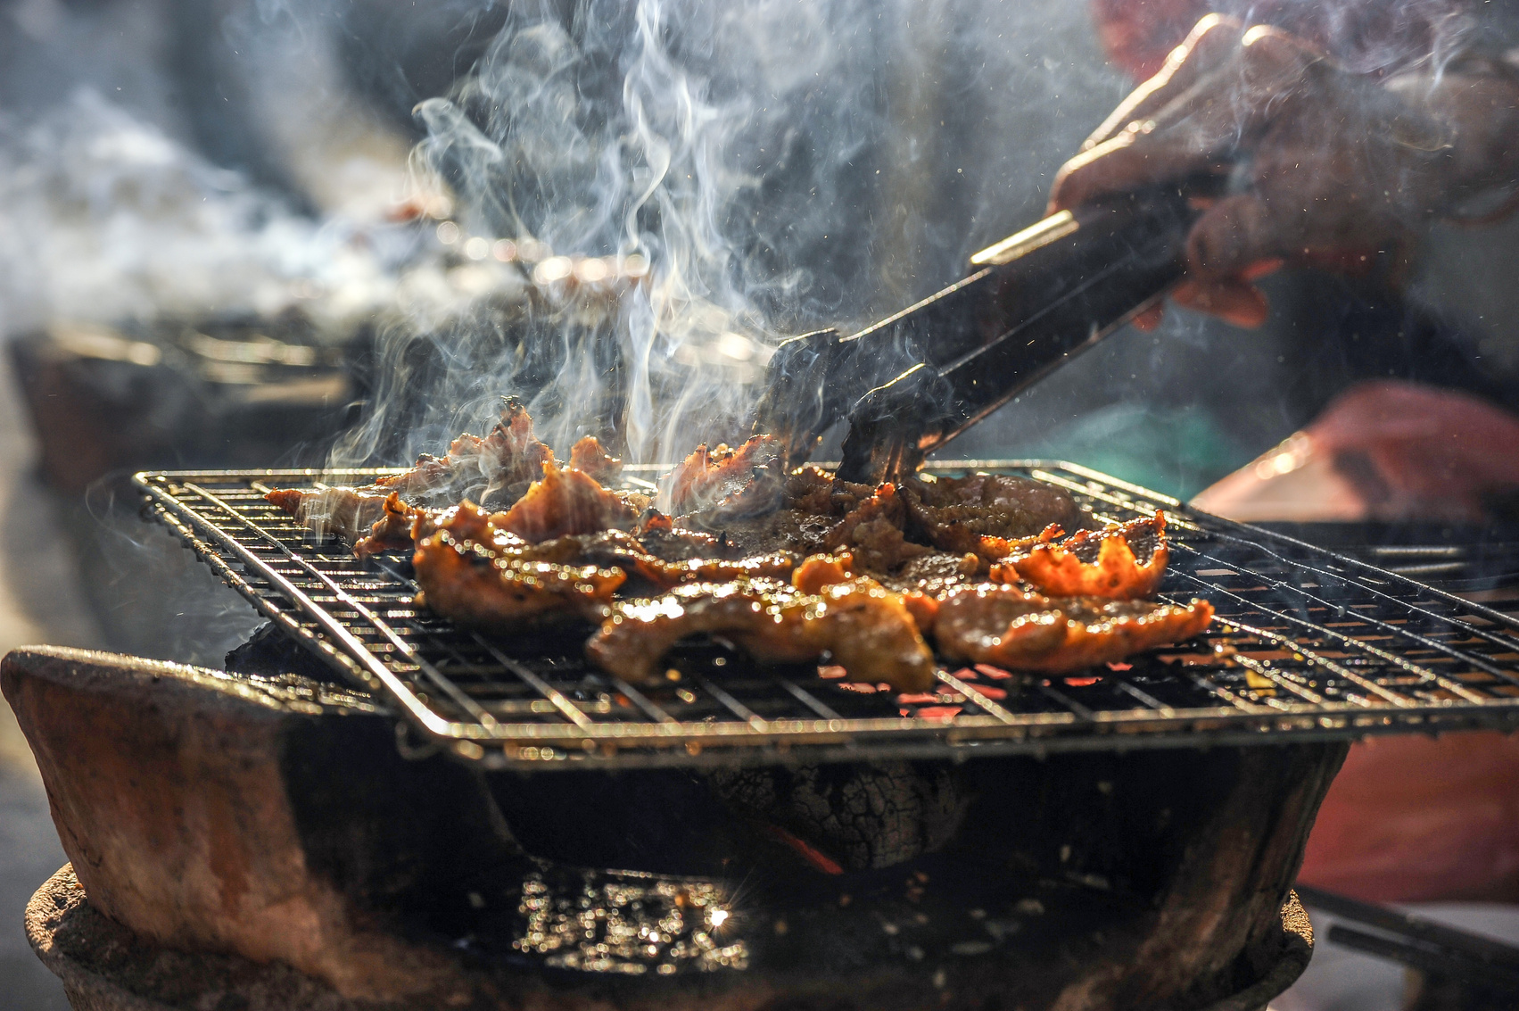

SIGN UP SHEET
Greenwood Park Pavilion Area
BBQ POTLUCK
08/08
15 PM
Full Name | Phone | Dishes | Quantity
Greenwood Park Pavilion Area | 123 Anywhere St., Any City
+123-456-789 | Jane Doe - BBQ Organizer

