Slide 1
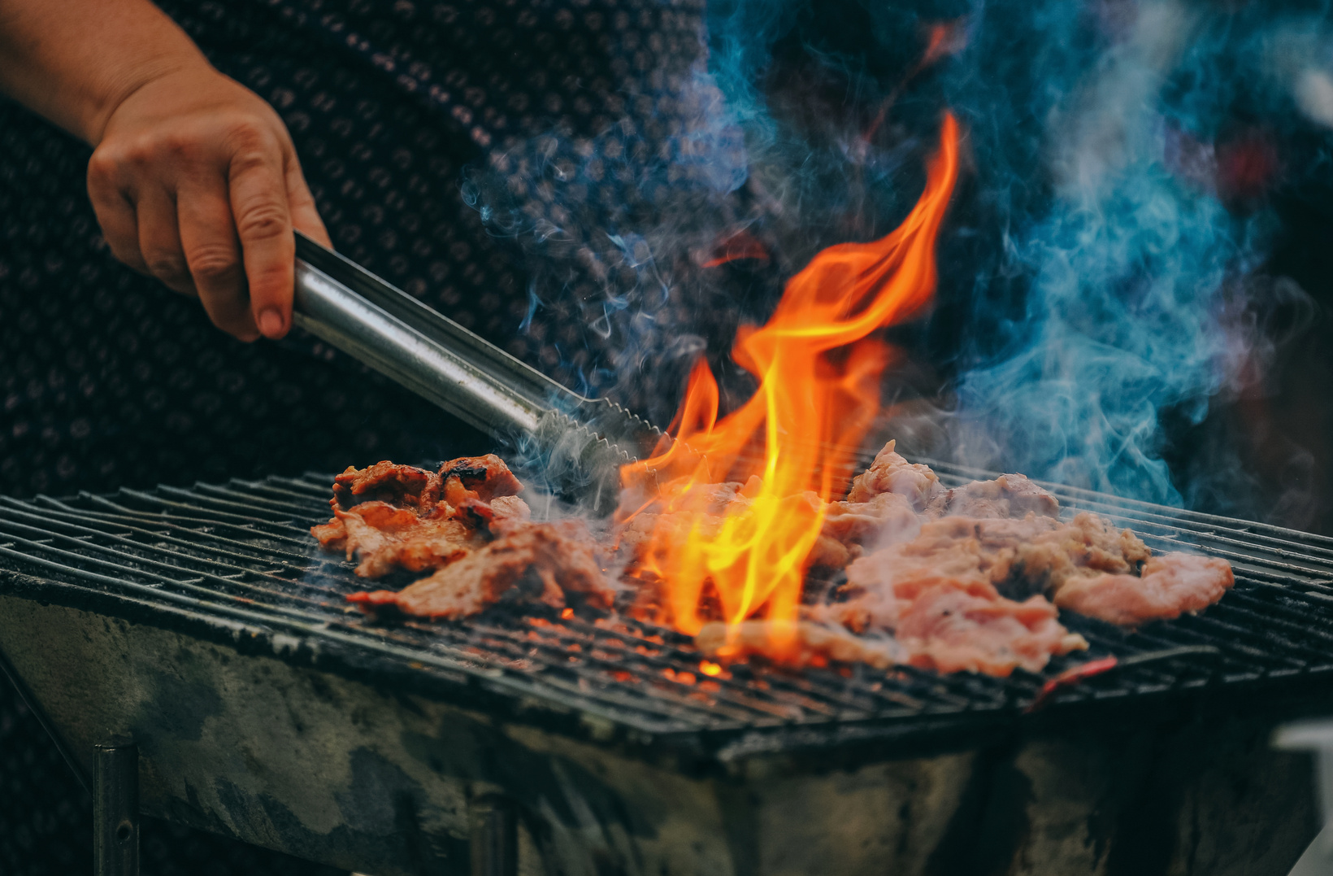


Cookout
Sign up Sheet
Autumn Harvest
Grill Master Contest
Outdoor Game Zone
Time
Date
Location
This sign-up sheet helps ensure all necessary items are covered and prevents duplicates. Please list what you plan to bring and include quantities if applicable
3:00 PM
– 8:00 PM
Saturday,
Dec 14, 2030
Greenland Park, Cookout Area A12
Full Name | Phone Number | Email | Item to Bring | Portion Size

