Slide 1
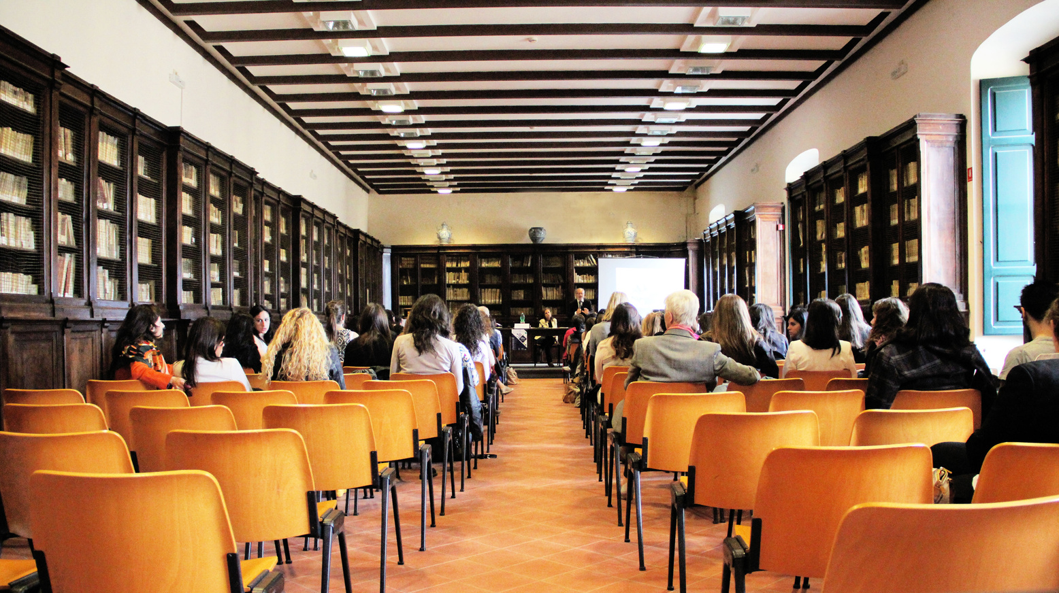

Conference .
Sign up Sheet
Full Name
Phone
Job Title
Time
Date
Location
9:00 AM - 4:30 PM
September 15, 2030
Grand Hall, Riverside Convention Center

