Slide 1
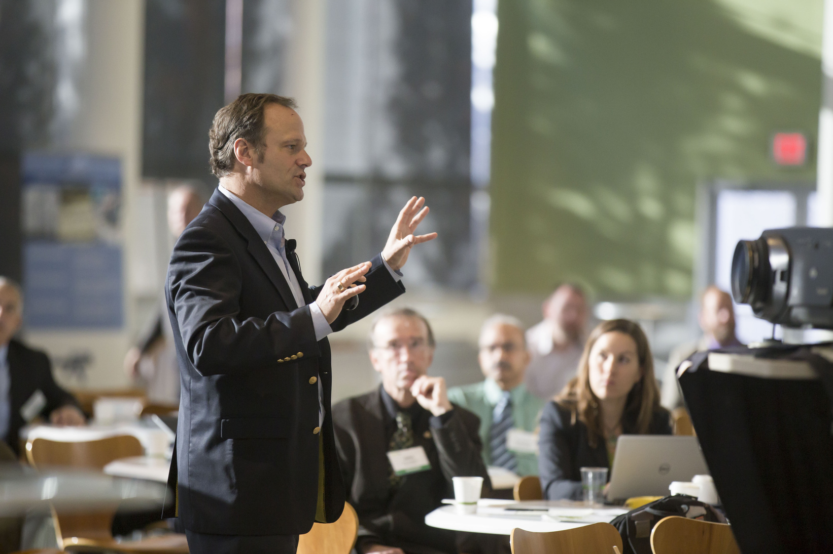

Sign up Sheet
Conference
FULL NAME
EMAIL
COMPANY NAME
Grand Hall | 123 River Street, Downtown Riverside, CA
Start from 07.00 am - 11.00 am
September 15, 2030

