Slide 1
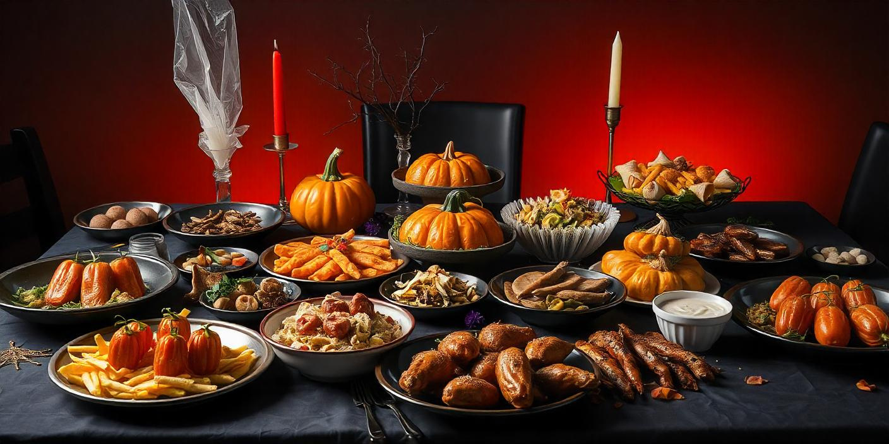

Community Center Hall, 123 Main Street
Start at
10:00 AM
SIGN UP SHEET
01.04.2030
HALLOWEEN POTLUCK
FULL NAME
PHONE
WILL BRING

