Slide 1
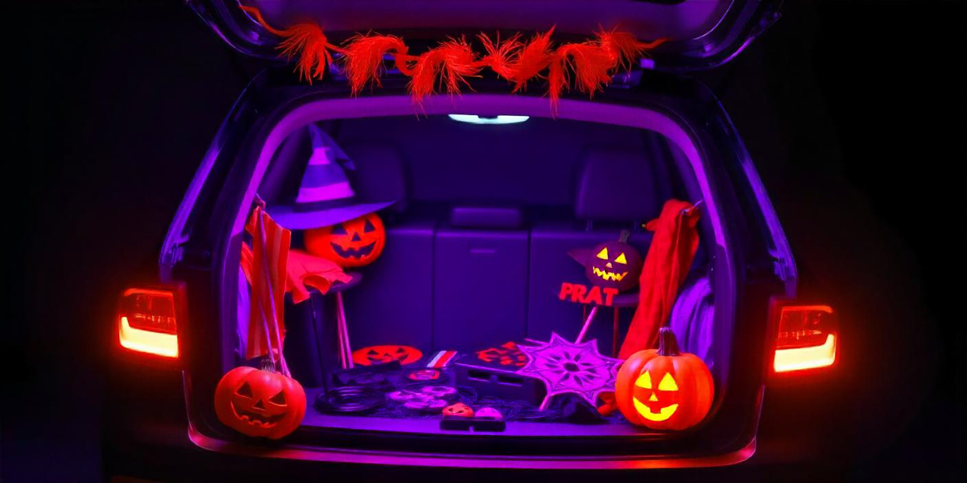

Sign up Sheet
Center Park
Trunk or Treat
31.10 | 3:00 PM
Participant Name | Phone | Trunk Theme

