Slide 1

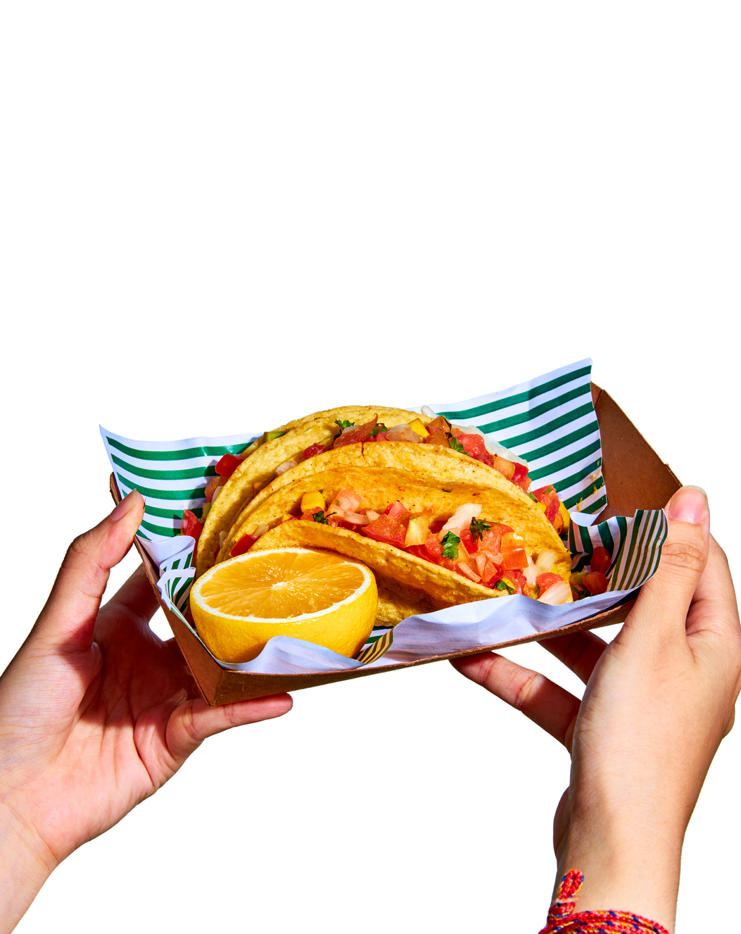


SIGN UP SHEET
WITH CHEF
Marina Red
TACO BAR
Full Name | Phone | Topping | Quantity | Note
Sunday | 03/11/2035 | 4 PM - 6 PM
Good Restaurant | 123 Main Street Hometown, USA

