Slide 1
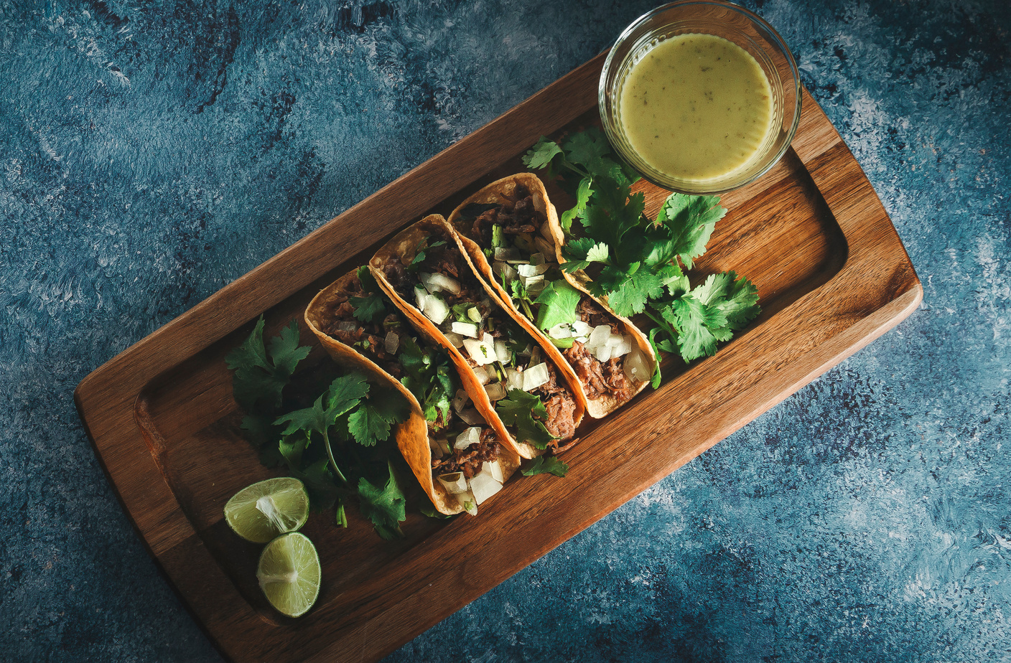

SIGN UP SHEET
TACO
BAR
08/08
15 PM
Good Restaurant
123 Main Street Hometown, USA
FULL NAME
PHONE
WILL BRING

